Slide 1
Transportation Electrification Vision and Strategy
Neal Callinan – Principal Strategist
November 16, 2021

Slide 2
In 2019, the Transportation Sector became the Highest Source of Carbon Emissions in the US
2
Source: Center for Climate and Energy Solutions
Notes:
Assumes an average of [$2.88 per gallon] based upon driving 11,500 miles. NPV - $800 per vehicle, per year
Kevin and Nadia
Kevin: These framework pillars show how we will ready our system and programs to attract and support 2 million EVs – not only do we provide the clean power for the cars, but we uniquely hold several other pieces of the puzzle to achieve the goal…
Nadia: Increasing adoption will require partnerships – with our states, communities, customers and commercial parties, like the OEMs. The OpCo teams have put together high-level stakeholder plans (outlined in the appendix) to secure key partners in their footprints. Innovative customer programs on the residential and C&I side are central to attracting more customers to go electric.
Nadia: Getting our system ready and making the needed investments and connections – both traditional forms and behind the meter opportunities, are plan cornerstones. Not only do we need to do this, but we must deliver with excellence to delight our customers with easy connections and programs that make going electric a no-brainer. I’ll turn it over to Kevin to discuss our role in more detail.

Slide 3
EVs Fit Xcel Energy’s Strategic Priorities
Lead the Clean Energy Transition
Enhance the Customer Experience
Keep Bills Low
Significant emissions reductions
Customer barriers the Utility can address
Lower rates through increased sales
Tons of CO₂ per Year
Share of Load by 2030 by EV Adoption Scenario
Lack of awareness or understanding
Upfront costs of charging infrastructure
Inability to access charging
Long charging times
Suboptimal incentives to charge when energy costs are lowest
5
Low
2
Likely
3%
1
High
3

Slide 4
Xcel Energy’s Bold 2030 EV Vision – The Next Frontier of Our
Clean Energy Leadership
1.5 MILLION EVs
On the road in the areas we serve by 2030
$1 BILLION
In customer fuel savings annually by 2030
$1 OR LESS PER GALLON
To drive an EV with Xcel Energy’s low, off-peak electricity prices
5 MILLION TONS OF CARBON EMISSIONS
Eliminated annually by 2030 with our clean energy
4
Notes:
We established a vision to power 1.5 million EVs across the areas we serve by 2030, replacing gas-powered models - That’s 20% of all vehicles, a 30-fold increase in Evs
$1 BILLION In customer fuel savings annually by 2030. An EV would cost $700 less per year to fuel than a gas-powered car
Through new electric vehicle customer programs and charging infrastructure, we will expand our clean energy leadership to transportation, developing innovative partnerships with our communities, customers and others. The vision means that 20% of all vehicles in the areas we serve would be replaced with electric vehicles by 2030.
$1 OR LESS PER GALLON To drive an EV when charged with Xcel Energy’s low, off-peak electricity prices
5 MILLION TONS OF CARBON EMISSIONS Eliminated annually by 2030 with our clean energy that’s about 3 tons of carbon reduction per vehicle
With 30 times more EVs on the road than today, we can:
• Help cut carbon emissions
• Lower fuel and maintenance costs for EV drivers
• Keep bills low for all customers
Our EV vision will allow everyone in the communities we serve to experience the benefits of electric transportation and improved air quality.

Slide 5
Our Current Programs Focus on Three Customer Needs
Raising engagement with educational & advisory services
Increasing access by lowering upfront costs
Reducing customer bills with managed charging
Residential customer outreach
Make-ready infrastructure programs
Time-varying rates
Community planning
Charging
equipment programs
Smart
charging
options
Fleet customer
assessments
Rebates (e.g.,
vehicle
purchase,
wiring)
5
Notes:
Assumes an average of [$2.88 per gallon] based upon driving 11,500 miles. NPV - $800 per vehicle, per year
Kevin and Nadia
Kevin: These framework pillars show how we will ready our system and programs to attract and support 2 million EVs – not only do we provide the clean power for the cars, but we uniquely hold several other pieces of the puzzle to achieve the goal…
Nadia: Increasing adoption will require partnerships – with our states, communities, customers and commercial parties, like the OEMs. The OpCo teams have put together high-level stakeholder plans (outlined in the appendix) to secure key partners in their footprints. Innovative customer programs on the residential and C&I side are central to attracting more customers to go electric.
Nadia: Getting our system ready and making the needed investments and connections – both traditional forms and behind the meter opportunities, are plan cornerstones. Not only do we need to do this, but we must deliver with excellence to delight our customers with easy connections and programs that make going electric a no-brainer. I’ll turn it over to Kevin to discuss our role in more detail.

Slide 6
Offerings Are Tailored to Market Segments
EV Accelerate
At Home
EV Accelerate
Your Fleet
EV Accelerate
On The Go
Single-family housing
Multi-family housing
Income-qualified customers in both groups above
Government (public)
Private Business
Covers medium- and heavy-duty
Public Charging on Corridors
Community Charging Hubs
Workplace/Office
Customers:
Additional barriers programs seek to address:
Insufficient awareness of opportunities
Hassle factor
Landlord-tenant issues
Misalignment between facilities and fleet management
Lack of business case
Gaps in network creating unmet need
6

Slide 7
Program Features:
Hassle-free installation of a Level 2 charger for more convenient and faster vehicle charging
We provide the charger and electrician to install it
We maintain the charger in working order
Lowers upfront cost for charger and install (hardwire and set-up of charger only)
Include charger service on your Xcel Energy bill for a low monthly fee of $17/mo
Charge overnight for more cost savings
ev.xcelenergy.com
7
Notes:
Customers only need a 240v circuit for the Level 2 charger.
Select from one of two approved level 2 chargers that allow us to read usage.
If customers wish to be added to our list of those who are interested to know about our program, they can email us at electricvehicles@xcelenergy.com

Slide 8
Program Features:
Full, turnkey approach for consultation, design, construction, and installation of EV make-ready infrastructure and charging equipment
Lowers upfront costs for installing EV charging
No cost for EV make-ready infrastructure (new dedicated EV meter cabinet w/ panel, conduit, etc.)
Include charger costs on your Xcel Energy bill for a low monthly fee
Access to low-cost EV charging rates and optimization programs
xcelenergy.com/CommercialEVs
8
Notes:
Customers only need a 240v circuit for the Level 2 charger.
Select from one of two approved level 2 chargers that allow us to read usage.
If customers wish to be added to our list of those who are interested to know about our program, they can email us at electricvehicles@xcelenergy.com

Slide 9
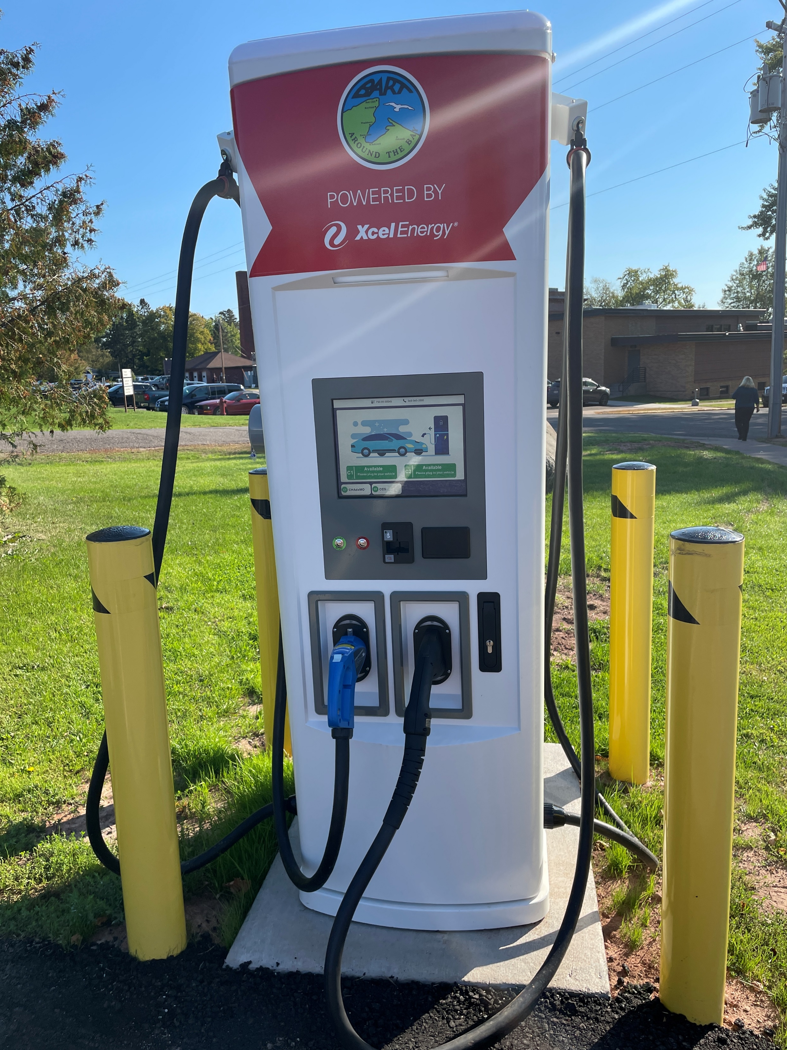
New Fast Charger Installed In Northwestern Wisconsin
Partners:
Xcel Energy
Bay Area Rural Transit (BART)
Bayfield County
Project Description
Level 3 EV fast charger in Washburn
To be used by BART to charge their all-electric buses that are scheduled to be in service later this year.
BART worked with Bayfield County to have the charger located in a visible area that could have point-of-sale capability for public use.
9

