Slide 1
Transportation Update
Craig Thompson
Secretary, Wisconsin Department of Transportation
Transportation Development Association of Wisconsin
Annual Meeting
November 16, 2021

Slide 2
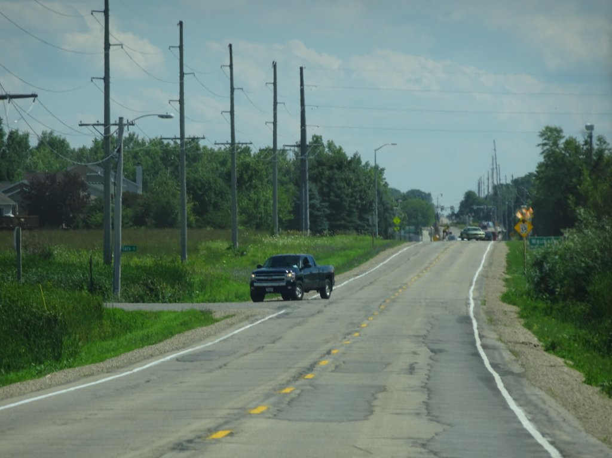
Mission: Stop the decline
Years of underinvestment

Slide 3
Delays before 2019
Stopped work/rescinded ROD on I-94 East-West
Stopped work on STH-15 (enumerated for construction)
I-43 not enumerated until SFY-2020
Cancelled I-39/90 Major Highway Study (Madison – WI Dells)
Slowed work on other Major Highway Study projects
US 51 – Stoughton to McFarland
US 51 – Beltline to STH 19

Slide 4
Progress after 2019
Enumerated I-43 and I-41
~ $500 million planned for FY-22 and FY-23 (I-43)
Restarted work to finish design and ready STH-15 construction
Successfully advanced letting start by 1-year; project is now under construction
Mainline open to traffic expected in November 2024
Restarted work in earnest on other Major Highway Study projects
US 51 – Stoughton to McFarland
US 51 – Beltline to STH 19
I-39/90/94 WI River Bridges - Obtained TPC Approval to Construct ($146 million estimate)
US-51 Stoughton to McFarland – Obtained TPC Approval to Construct ($203 million estimate)
I-39/90 Madison to Wisconsin Dells - Restarted Major Highway Environmental Study Project
I-94 East-West –Work Started to Reinstate the ROD
4

Slide 5
2020 Highlights
Staying On Track
Competed 375 construction projects statewide, most of which are new
Innovative programs allowed WisDOT to finish many projects under budget and ahead of schedule

Slide 6
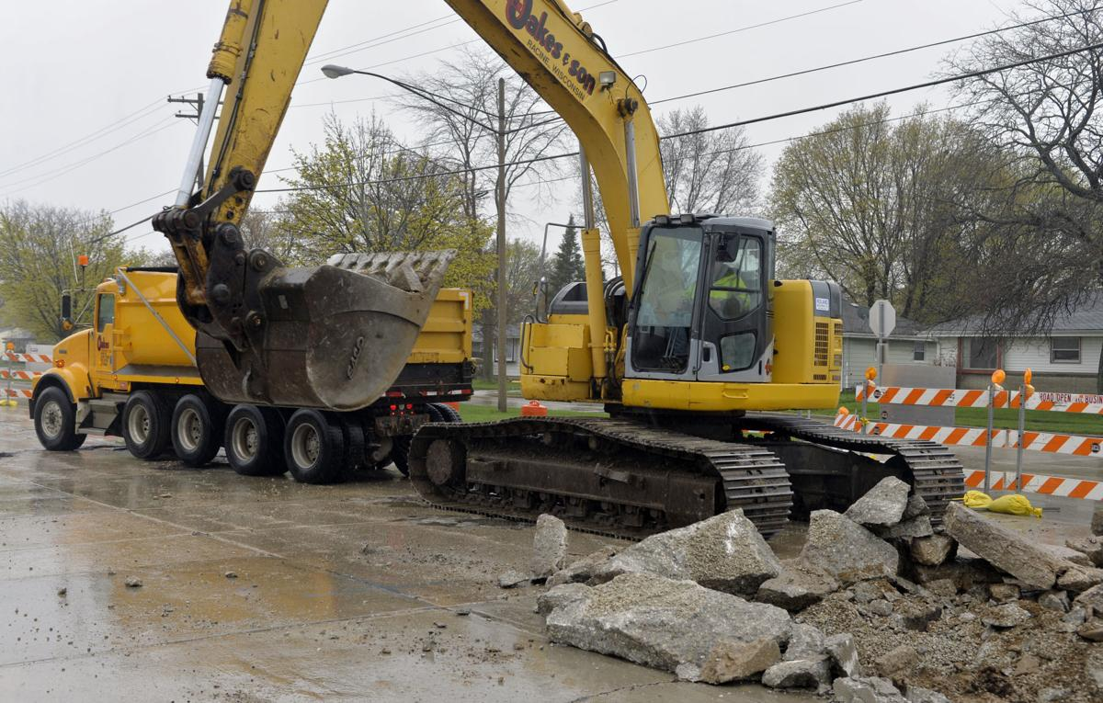
2021-2023 Budget
Continuing our Commitment to
Fix What We Have
Increases for local roads
$72 million increase for SHR
GTA up two percent in both 2022 and 2023
$100 M in LRIP Discretionary Funds

Slide 7
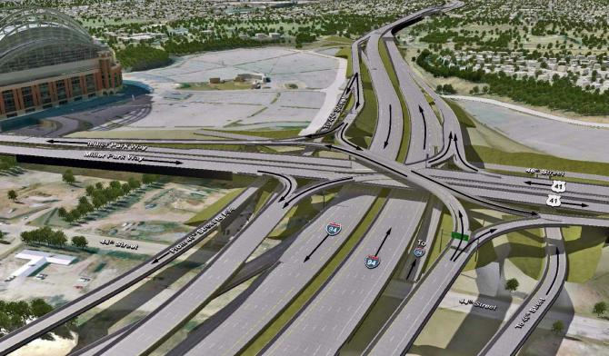
I-94 East West Corridor
Project enumerated
Supplemental EIS started
Focus on community engagement

Slide 8
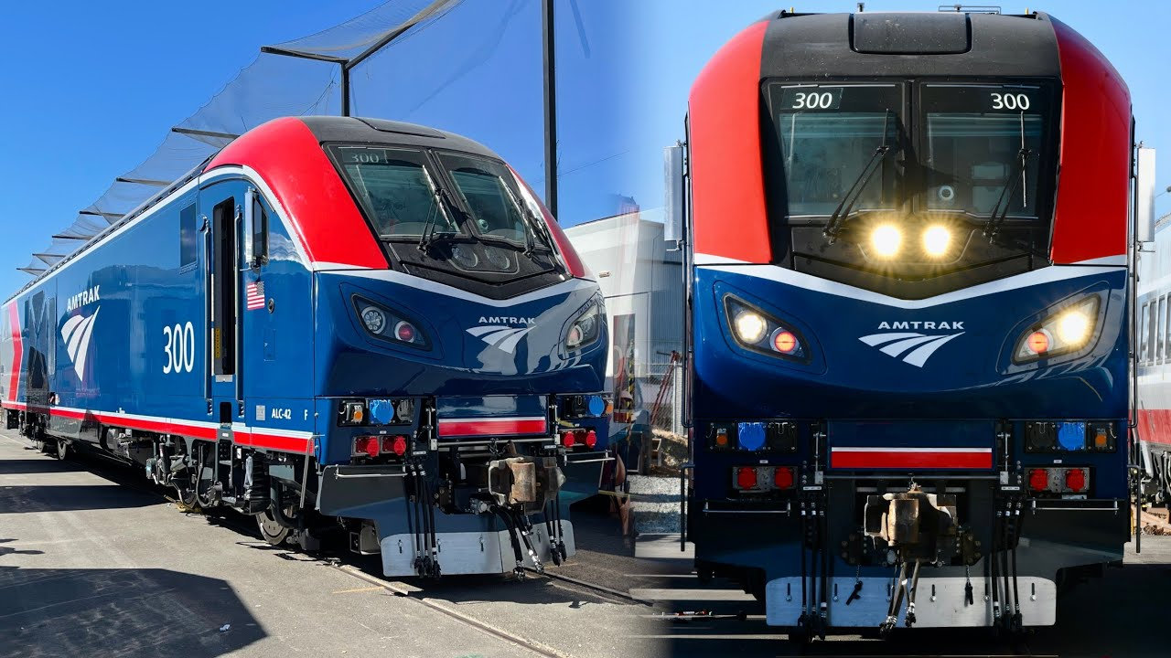
Passenger Rail
Twin Cities – Milwaukee – Chicago service expands
Extension of Hiawatha service on Empire Builder route

Slide 9
Federal Legislative Update
Infrastructure Investment and Jobs Act
$1.2 trillion authorization bill
Most historic since the development of the Interstate system

Slide 10
Infrastructure Investment and Jobs Act
$5.2 billion for federal aid highway-apportioned programs
$1.1 billion in new funding over five years
$225 million for bridge replacement and repairs

Slide 11
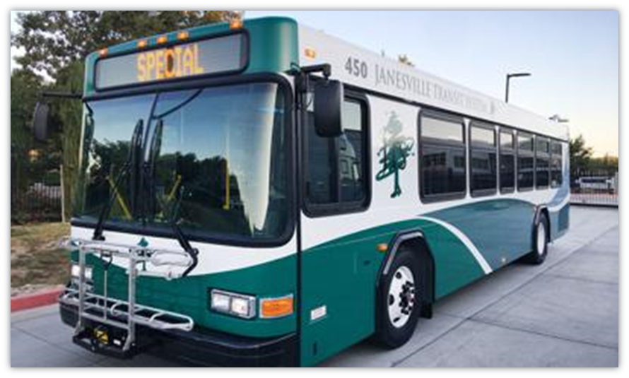
Transit
$594.7 million in federal-aid transit formula funding over the next five years
Increases about 30% in the first year and about 2% each subsequent year
Funds will permit the state’s transit systems to improve and expand public transportation.
d

Slide 12
Electric Vehicles
$15.7 million per year
$78.6 million over five years

Slide 13
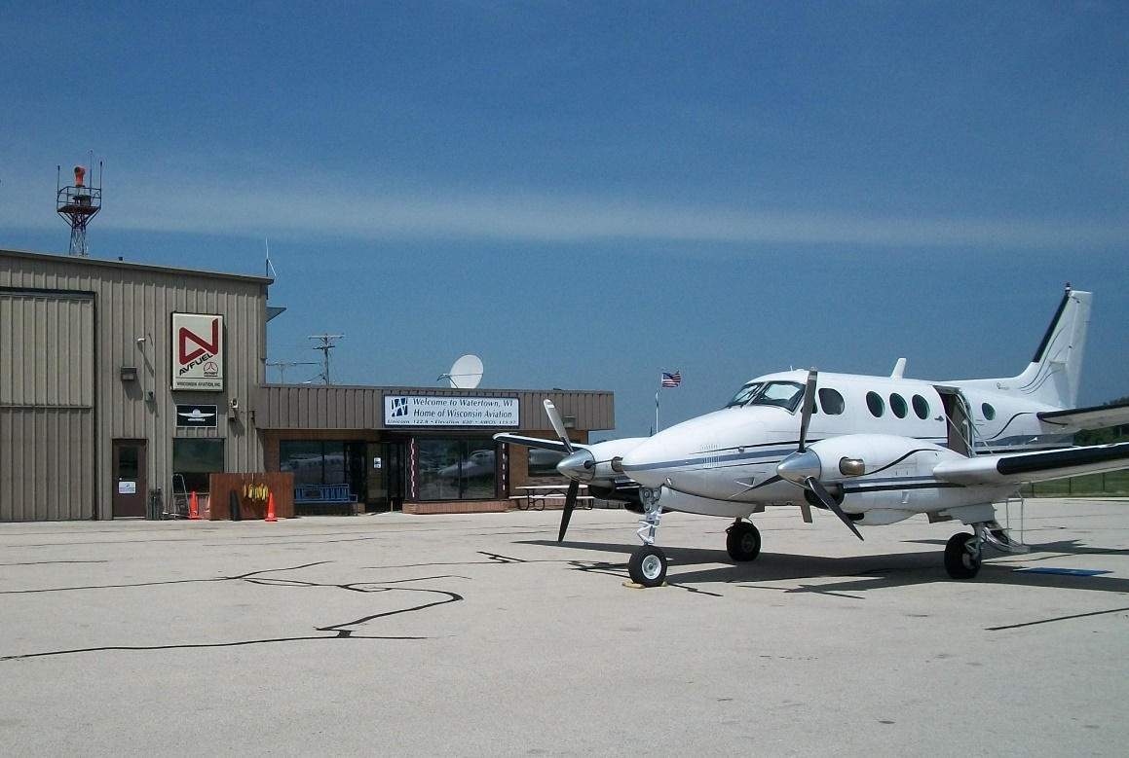
Airports
$66.7M to $74.4M per year
Potential to double federal funding for Wisconsin airports

Slide 14
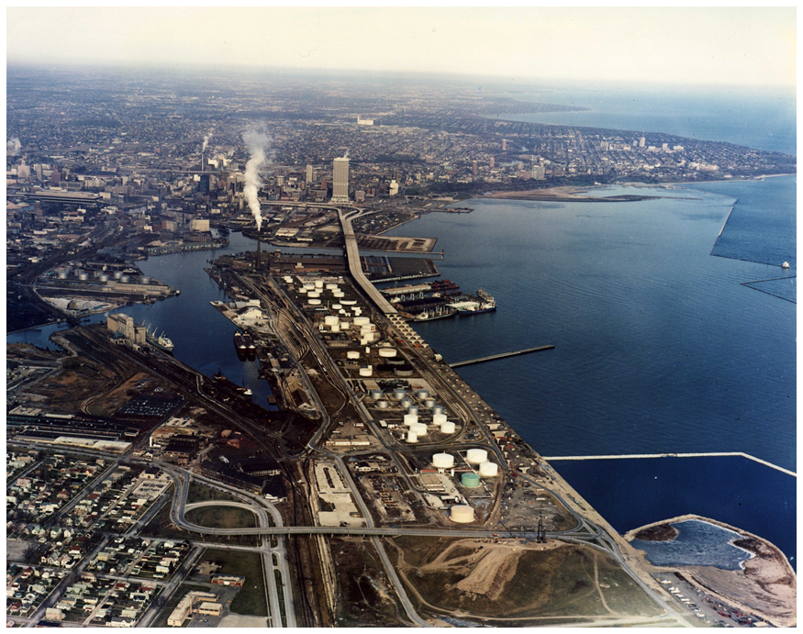
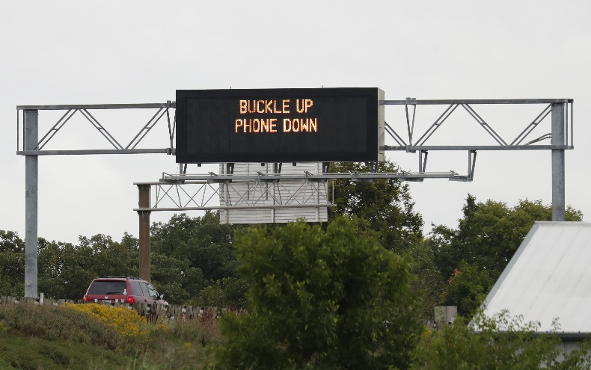
2020 Highlights
Rail, Harbors, Highway Safety
Highway safety
Rail crossings and infrastructure
Harbors and ferry boats

Slide 15
Next Steps
Congress must appropriate the funds authorized in IIJA
Increased funding in current biennium requires WisDOT to create a new federal expenditure plan
In future years, program funding will be part of the biennial budget

Slide 16
Thank You!

