Slide 1
TDA annual Meeting – electric vehicles
Debbie Branson
Madison Gas and Electric

Slide 2
Agenda
Electric Vehicle Trends
MGE Charging Solutions
MGE Partnerships
MGE EV Resources
Questions
Notes:
Commission framework – managed charging
Move charging when capacity or renewables are available – make better use of the distribution system
Charge Ahead pilot – move more than 92% of energy to off-peak won’t be the need to curtail on peak days

Slide 3
Electric Vehicle trends
In Dane County, 70% increase in EV sales from 2020 to 2021
EV sales growing faster than gasoline vehicle sales
National EV registrations increased 46% from third quarter 2020 to first quarter 2021; ICE registrations only increased 4%
More models available – pickups, SUVs
Longer range – more than 300 miles, future models more than 400
Lower fuel and maintenance costs
Fun to drive
EVs expected to reach price parity 2025 to 2028
Notes:
Commission framework – managed charging
Move charging when capacity or renewables are available – make better use of the distribution system
Charge Ahead pilot – move more than 92% of energy to off-peak won’t be the need to curtail on peak days

Slide 4
Electric vehicle Trends
The right mix of public charging is important
Level 2 stations were critical early on – smaller batteries, shorter range
Today, MGE Level 2 stations are used less than 2% of the time
MGE owns 45 public charging stations; EV charging hub opening 2021
99 public charging stations in Madison area; more businesses investing in charging infrastructure
DC fast charging important for local and statewide EV adoption
Enable long-distance travel
Surveys show that lack of charging for travel is a barrier to EV adoption
Notes:
Commission framework – managed charging
Move charging when capacity or renewables are available – make better use of the distribution system
Charge Ahead pilot – move more than 92% of energy to off-peak won’t be the need to curtail on peak days

Slide 5
Electric Vehicle Trends
Apartment developers very interested in providing charging to residents
Amenities to recruit and to keep residents
EV Ordinance requires charging infrastructure in new construction
EV infrastructure also important to economic development
UPS, Amazon, and FedEx all adopting electric vehicles
Seek out locations where there are incentives, public charging infrastructure, utility programs
On-site charging and fast charging are both in demand
Notes:
Commission framework – managed charging
Move charging when capacity or renewables are available – make better use of the distribution system
Charge Ahead pilot – move more than 92% of energy to off-peak won’t be the need to curtail on peak days

Slide 6
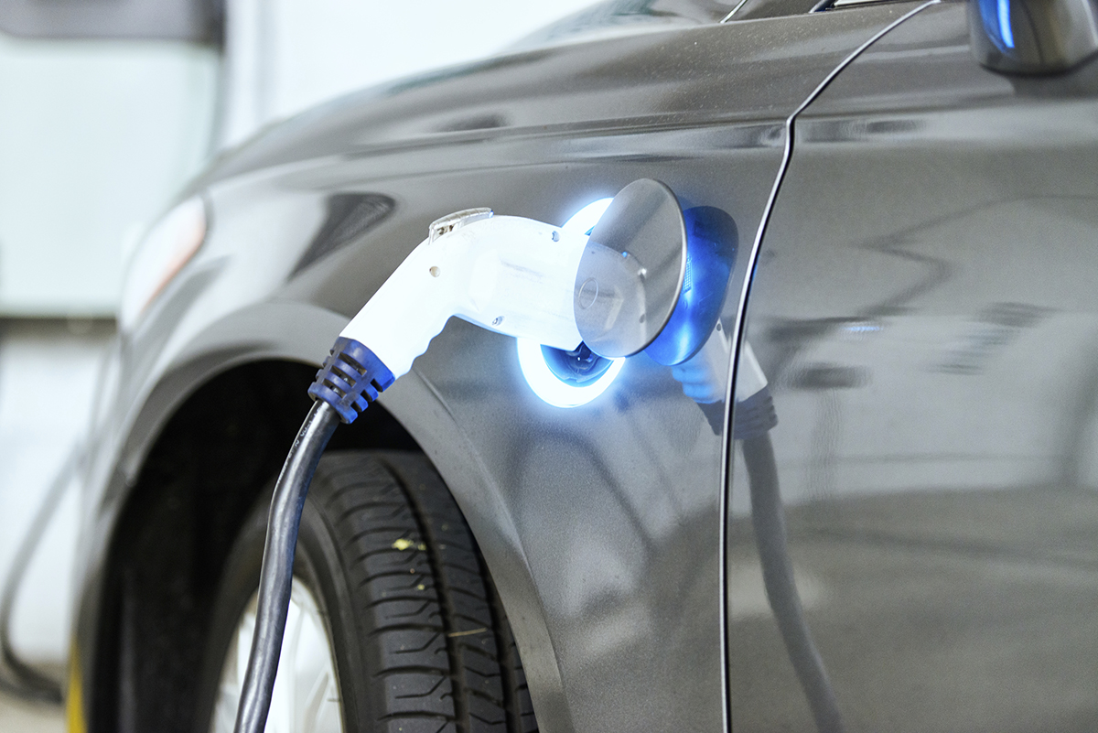
MGE Charging Solutions
MGE offers resources and programs for each step of the customer journey
MGE charging solutions
Charge@Home
Charge Ahead
Apartment Charging
Workplace Charging
Fleet Charging
EV Charging Hub and network
Notes:
Commission framework – managed charging
Move charging when capacity or renewables are available – make better use of the distribution system
Charge Ahead pilot – move more than 92% of energy to off-peak won’t be the need to curtail on peak days

Slide 7
MGE Charging solutions - highlights
All programs include managed charging
Moving charging to lower cost periods or when renewables are available.
Helps MGE prepare for additional charging on the grid
Ensures that EV charging benefits all customers
Reduces the need for electrical system upgrades and new generation facilities
Notes:
Commission framework – managed charging
Move charging when capacity or renewables are available – make better use of the distribution system
Charge Ahead pilot – move more than 92% of energy to off-peak won’t be the need to curtail on peak days

Slide 8
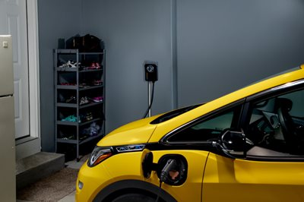
Charge@home pilot
80% of charging happens at home
Convenience
MGE coordinates installation of Level 2 network charging stations
No up-front costs
Customer pays monthly fee for equipment and installation
MGE can view and manage charging
Study charging patterns, prepare for more EV charging on the grid

Slide 9
Charge@home Pilot
145 customers enrolled – big uptick in enrollments in 2021
Customer satisfaction survey results
100% of participants were extremely or somewhat satisfied
About 90% of customers agreed that Charge@Home is a good value
Similar to national data, approximately 89% of charging happens at home with the workplace being the second most common place to charge

Slide 10
Charging trends
Customers have more charging options
Lower cost 240-Volt cords are available through auto manufacturers
Dealership and retailers like Amazon sell stations
Chevy will coordinate installation for Bolt buyers
Vehicle telematic software allows MGE to view and manage charging
No charging station required
Notes:
First some background on charging trends

Slide 11
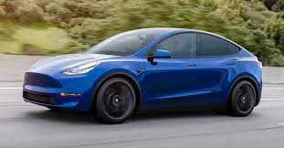
Charge Ahead Project
MGE launched Charge Ahead demonstration project in March 2021
Recruited 16 Tesla drivers
MGE evaluated using a software platform to manage charging through the vehicles on-board modem
Customers provided a need-by time and software optimized charging
“Set it and forget it” approach will appeal to customers, particularly mainstream vehicle owners
Allows insight into the battery state of charge and helps ensure a full battery when needed
Notes:
58% of all-electrics are Teslas
44% of EV are Teslas

Slide 12
Charge Ahead project
Rewarded customers for allowing MGE to optimize charging
Approximately 95% of charging loads were shifted to off-peak hours
Customer survey results
Most want to help manage the grid, interested in new technology
90% found managed charging convenient
90% confident vehicle would be charged and ready
Expanding Charge Ahead to evaluate different charging scenarios
Shift charging to times when renewables are available

Slide 13
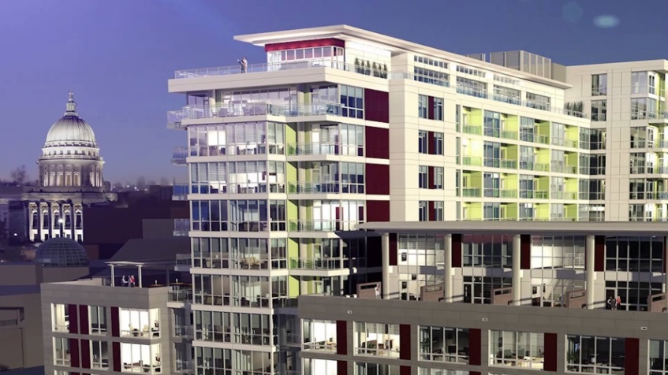
Apartment EV charging
More than 50% of residents are renters (80% of charging happens at home)
MGE provides a non-network Level 2 charging station to apartment property owners
Developer responsible for installation
Required to survey residents
Stations installed at 37 properties
Garver Point, Galaxie, Factory District, The Lyric
87% of residents support the installation of EV charging stations

Slide 14
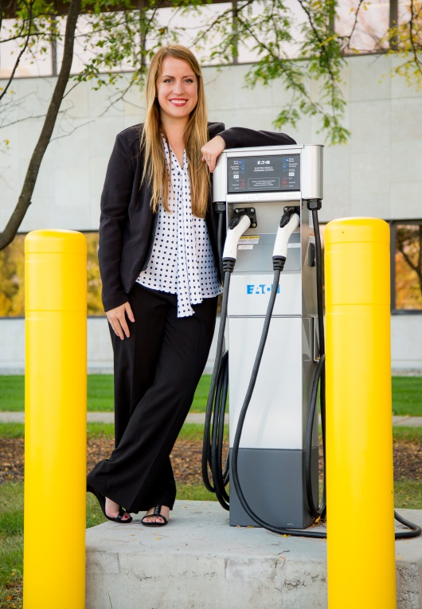
Workplace Charging
MGE provides a non-network Level 2 charging station to businesses
Developer provides infrastructure to power stations
Stations installed at 22 locations
Large and small businesses interested
59% support their employer installing on-site charging
51% are more likely to consider an EV if their employer offers workplace charging
MGE offers on-site charging for employees

Slide 15
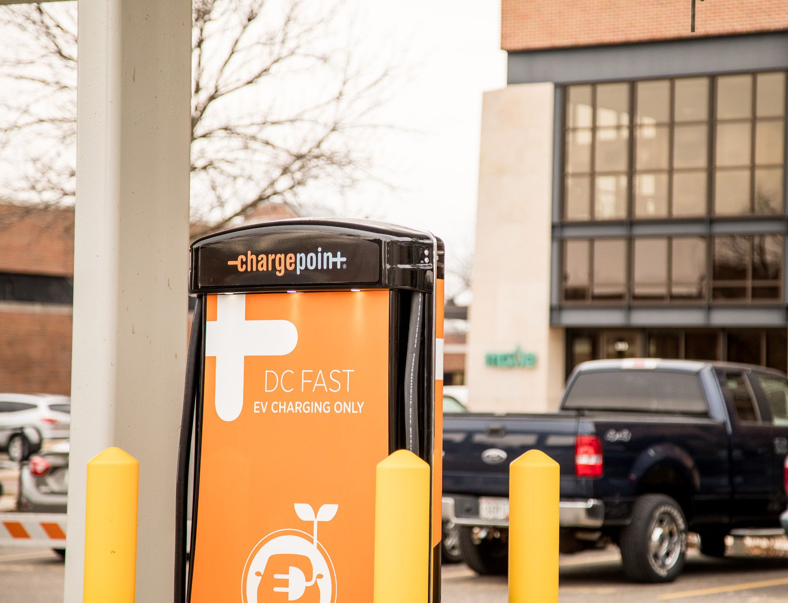
Public Charging
Plenty of opportunities to charge on the go
MGE owns and operates 45 public charging stations
Five DC fast chargers
100% powered by wind energy
L2 stations cost $2/hour; fast chargers cost $5/hour
EV Owners Group members get a 50% discount

Slide 16
Fast Charging hub
Site dedicated to electric vehicle charging – 16 stalls on the corner of East Washington Avenue and South Livingston Street
MGE installing high-speed chargers up to 350 kW
Tesla installing eight 250-kW Superchargers
Taxi and ride-sharing services going electric – Green Cab, Uber
Options for people who don't have a way to charge at home
Prepare for fleets wanting to charge inter-city
Opening in 2021

Slide 17
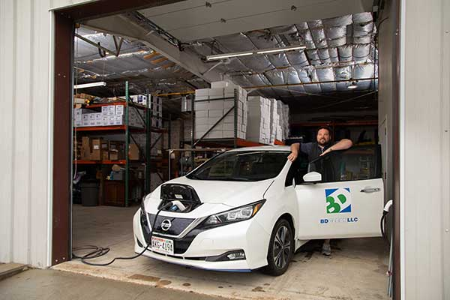
Fleet Vehicle Charging
MGE fleet programs and services
EV Fleet Analysis (no cost)
Assist with charger installation
Electric Vehicle Fleet Rate – Reduction in demand charges over 4-year period
LovEV website
MGE is targeting a goal of 100% all-electric or plug-in hybrid light-duty vehicles by 2030
Getting first-hand experience to better support our customers transitioning to EVs
Notes:
30 EVs in our fleet right now, including vehicles with electric powered auxiliary equipment

Slide 18
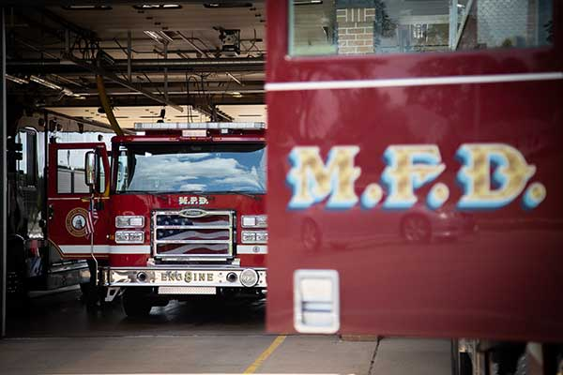
Partnerships
City of Madison Fleet Services
Received OEI grant to purchase 20 Chevy Bolts
MGE provided funding to purchase charging stations
Electric Kenworth semi – scheduled for 2022
City of Madison Fire Department
MGE provided DC fast charger; studying charging patterns and bill impact
City of Madison Metro Transit
3 electric buses ordered; MGE provided support, charging, technical expertise
Notes:
Awarded FTA low- or no-emission funding opportunity
$1.3 million for three Proterra buses, three charging stations
MGE contributed local match for charging infrastructure and is providing technical assistance

Slide 19
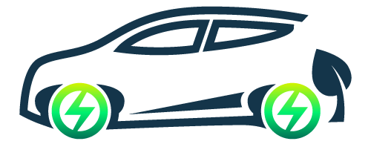
EV Resources
Explore My EV mge.com/ExploreMyEV – online tool for comparing EVs to gas vehicles
EV Rider mge2050.com/EVRider – easy to understand information on EVs, feature videos, short articles and interviews with experts
EV web site mge.com/LovEV – information about models, driving range, costs, emissions and charging
EV Owners Group – 50% discount at MGE public charging stations
EV Fleet Analysis – use vehicle telematics to determine if EVs are a good fit, total cost of ownership

Slide 20
Questions?
Thank you.
Debbie Branson
Madison Gas and Electric

