Slide 1

The State of Wisconsin Transportation
March 26, 2025

Slide 2
Wisconsin’s Transportation-Dependent Economy
Transportation-Dependent Industries Critical for Wisconsin
Employment & Wage Shares, Manufacturing, Trucking, Agriculture, & Mining, WI & US, 2023

Slide 3
How Wisconsin Compares to Its Neighbors
Transportation-Dependent Sectors, 2023
Employment
Wages

Slide 4
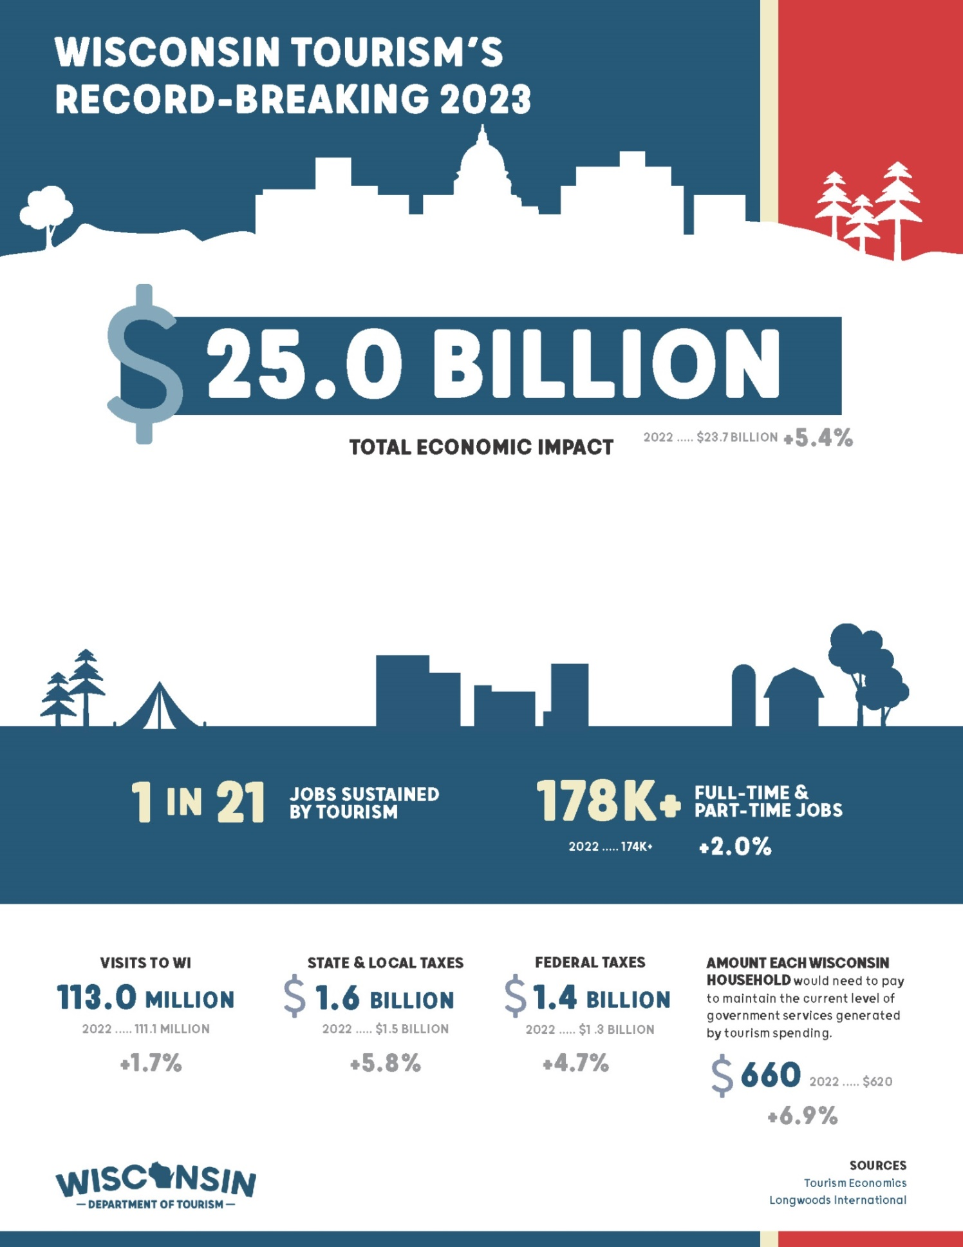
Over 100 Million Tourism Visits Each Year, Most by Car, Depend on Good Roads
113 million visits generate $15.7 billion in direct sales, resulting in:
  $1.6 billion in state and local taxes.
  $1.4 billion in federal taxes.
Each Wisconsin household would need to pay $660 in taxes to maintain the current level of government services generated by tourism spending.
Source: Wisconsin Department of Tourism

Slide 5
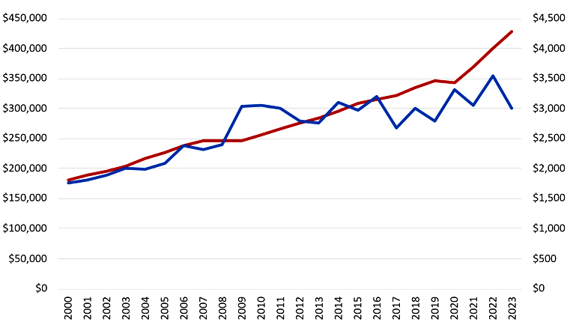
Investment is Not Keeping Up with the Economy
2000-2023 | In Millions
Transportation Spending
GDP
Before 2017, annual transportation spending was about 1% of GDP.
Nominal GDP
Total
Transportation Spending

Slide 6
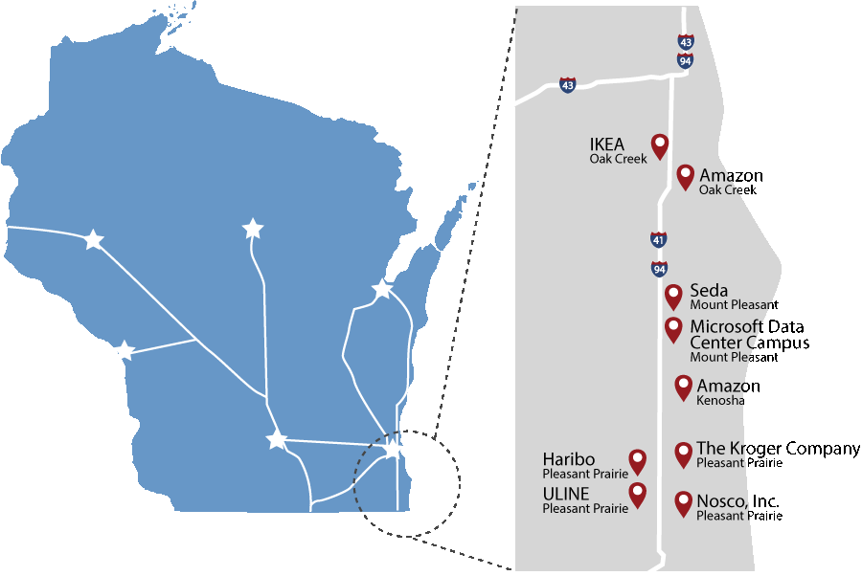
Strategic Investment Drives Economic Opportunity
Case Study: Business Booms Along Improved I-94 N-S
$2 billion investment = $11 billion (108%) increase in assessed property values along the corridor since 2015, compared to 30% in the rest of Milwaukee, Kenosha, and Racine counties.
Source: Analysis of assessed property values within three miles of the modernized corridor versus the rest of properties within the counties.

Slide 7
How Wisconsin Funds Transportation

Slide 8
Federal Funds and State Gas Tax Now Vie for Single Largest Source
41.5% Gas Tax
37.1% Reg. & Title Fees
1.8% EV Sales Tax
10.7% Non-recurring GPR Transfer
8.9% Other State Funds
Source: Wisconsin Department of Transportation

Slide 9
Transportation User Fees Don’t Grow with the Economy Like General Fund Taxes (2024 constant dollars)
IN MILLIONS
General Fund tax collections in 2024 dollars (CPI) increased 14%, despite tax cuts, with growing incomes, prices, and consumer spending buoying the fund.
Transportation user fee revenue (in 2024 $s, WCCI) decreased 32% despite some fee increases.
14%
-32%
Graph Sources: Comprehensive Annual Financial Reports, WisDOT (excludes transfers, PECFA, misc. revenue, and investment income). Adjusted for inflation General Fund taxes using CPI and Transportation Fund User fees with Wisconsin Construction Cost Index.

Slide 10
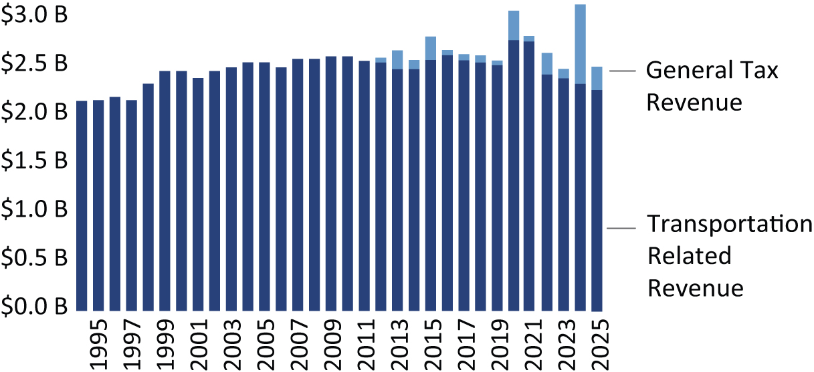
Inflation Adjusted Transportation Revenue Lowest Since 1998
Total transportation revenue by fiscal year 1994 to 2025, adjusted to 2023 dollars (CPI)
Wisconsin Policy Forum Report – Road Map: Assessing and funding Wisconsin's transportation needs, Dec. 2024

Slide 11
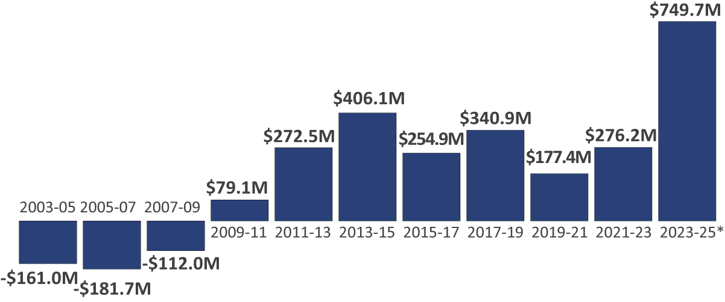
Wisconsin Increasingly Relies on General Fund Revenue for Transportation
Revenues transferred from the transportation fund to the general fund
Dollars from the general fund to the transportation fund
Wisconsin Policy Forum Report – Road Map: Assessing and funding Wisconsin's transportation needs, Dec. 2024. 2023-25 transfers don’t include $228.7 transit funding paid directly from the General Fund.

Slide 12
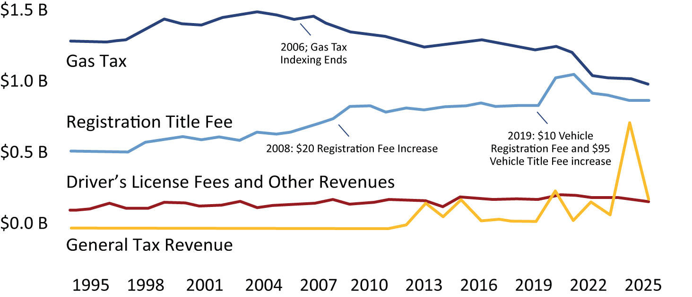
State Gas Tax has Not Kept Pace with Inflation Since 2006
Major state transportation fund revenue sources, state fiscal years, adjusted for inflation to 2023 dollars (CPI)
Wisconsin Policy Forum Report – Road Map: Assessing and funding Wisconsin's transportation needs, Dec. 2024

Slide 13
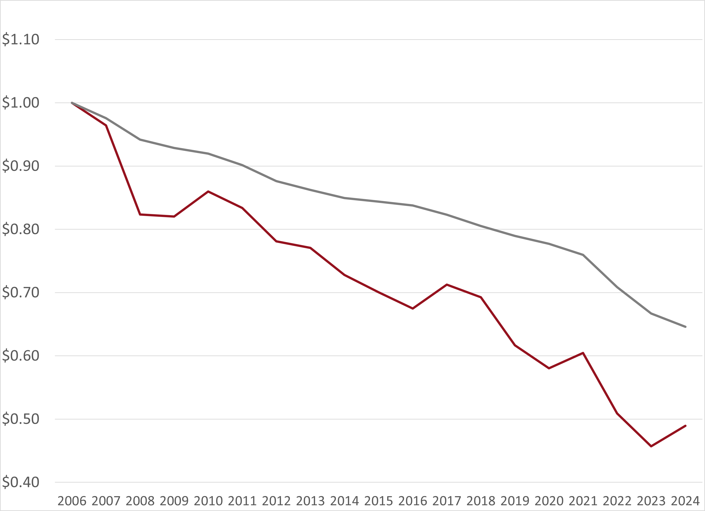
Gas Tax Purchasing Power Declines, Construction Cost Inflation Outpaces CPI
$1.00
CPI:>30% decrease in purchasing power
$0.65
$0.49
Wis. Construction Cost Index: 50+%

Slide 14
Construction Inflation Reduces Number of Road Improvement Projects
$100 Million Investment (in 2004 constant dollars using CPI)
Despite Investment levels staying constant (CPI),the number of miles reconstructed declines as Wisconsin Construction Inflation outpaces CPI.
Miles Reconstructed
Explanation: Calculation is made using Iowa County reconstruction numbers. Reconstruction costs will vary by county and type of road. However, the trend in road miles 2004 vs. 2024 will be similar.

Slide 15
Motorist Are Paying Less in Gas Tax
Average fuel efficiency increased from 20.3 MPG in 2006 to 25.4 MPG.
Motorists driving 12,000 miles/year buys 118.7 fewer gallons than in 2006.
And pays $36.68 less in today’s dollars, about $90 in constant 2006 dollars.
2025 25.4 MPG
2006 20.3 MPG
$36.68
Less Gas Tax Paid
Source: Legislative Fiscal Bureau Paper, Jan. 2025

Slide 16
Fuel-Efficient Vehicles Equal Gas Tax Break
Fuel Efficiency’s Gas Tax Cut
The 25% increase in fuel economy since 2006 results in reduction for the average motorist equal to about 7.8 cents per gallon.
Or an estimated $267 million in gas tax revenue annually.
7.8¢
per gallon
Source: Legislative Fiscal Bureau Paper, Jan. 2025

Slide 17
Gas-Powered Vehicles Are Not Going Away Soon
Registered Hybrid and EV Percentages of
Wisconsin Passenger Vehicle Fleet
Nearly 97%
of Wisconsin’s 4.8M passenger vehicle fleet are non-hybrid, gas-powered vehicles.
2.67%
0.48%
Source: Wisconsin Department of Transportation

Slide 18
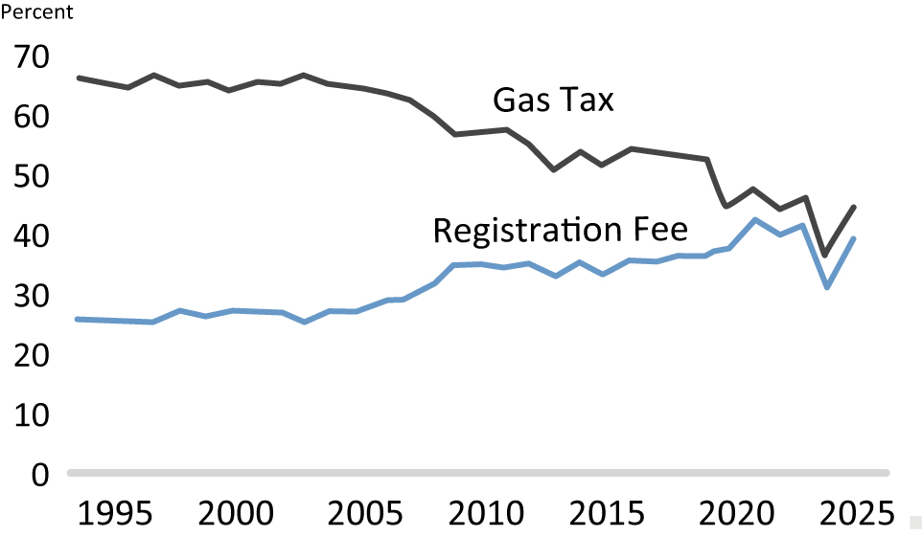
Registration Fee Revenue Now Rivals Gas Tax
Gas tax and vehicle registration and title fees revenue as a percentage of total transportation fund revenue, including general fund contributions
Wisconsin Policy Forum Report – Road Map: Assessing and funding Wisconsin's transportation needs, Dec. 2024

Slide 19
Wisconsin Bends the Debt Service Trend with Historically Low Bonding Levels
IN MILLIONS
*
*
Graph source: Legislative Fiscal Bureau
* Governor’s budget proposal.

Slide 20
Where the Money Goes

Slide 21
All Funds Budget Overview of Spending

Slide 22
Majority of Highway Spending Aimed at Maintaining Highway Conditions
Source: Wisconsin Department of Transportation, 2023-25 all funds budget, includes amounts paid from General Fund.

Slide 23
Local Funding Split Between Capital & Operations
Local Program Detail
Source: Wisconsin Department of Transportation, 2023-25 all funds budget, includes amounts paid from General Fund.

Slide 24
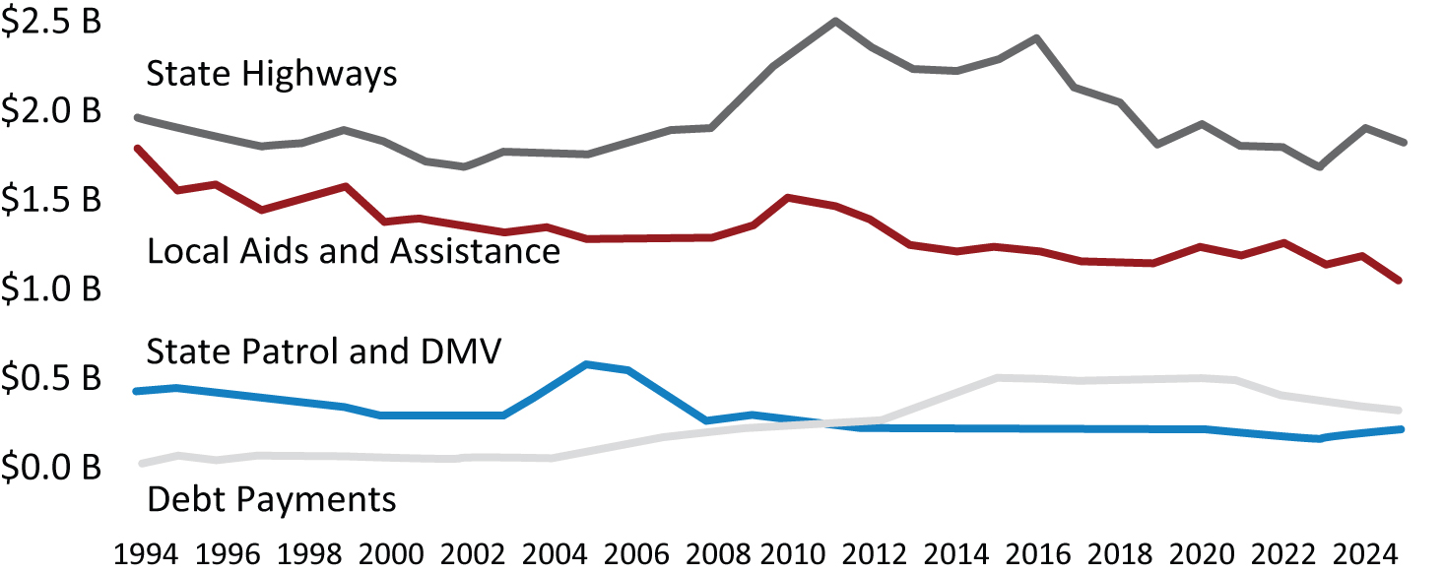
Current Highway and Local Spending Below 1994 Levels in Real Dollars
Spending by area, three-year rolling average, 1994 to 2025, inflation adjusted to 2023 dollars using CPI
Wisconsin Policy Forum Report – Road Map: Assessing and funding Wisconsin's transportation needs, Dec. 2024

Slide 25
System Conditions

Slide 26
Highway Conditions Stabilize, Unsustainable with Current Funding
Conditions stabilized with an increase of more than $500 million in State Highway Rehabilitation funding since the 2017-19 biennium.
Without additional SHR funding, WisDOT estimates the system conditions could decline 10% over the next decade.
WisDOT
Target
Source: Wisconsin Department of Transportation, MAPSS. Conditions collected the year before reported. No results in 2021 due to COVID.
WisDOT’s target is 85% fair or better.

Slide 27
Majors Funding Hasn’t Grown in Decades, Modernization Needs Have
IN MILLIONS
$456
$391.8
Historical Base Funding
Source: Feb. 1 Transportation Projects Commission report. WisDOT response to inquiry.

Slide 28
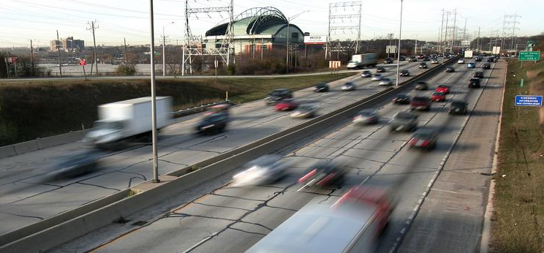
I-94 East-West Next SE Project
60-year-old roadway links updated Zoo and Marquette interchanges
27% of jobs and 35% of businesses in the 7-county region are within five miles of the Stadium Interchange
Project addresses all the corridor’s known issues, specifically severe congestion and related safety challenges
Construction to start on the $1.74 billion (year of expenditure $) project in late 2025
Average of about $400 million per biennium will be needed over the next 3 budgets, $200 million+ in SFY 2032
Any delay will add millions to the cost ($100 million+ since 2017 turnback of ROD)

Slide 29
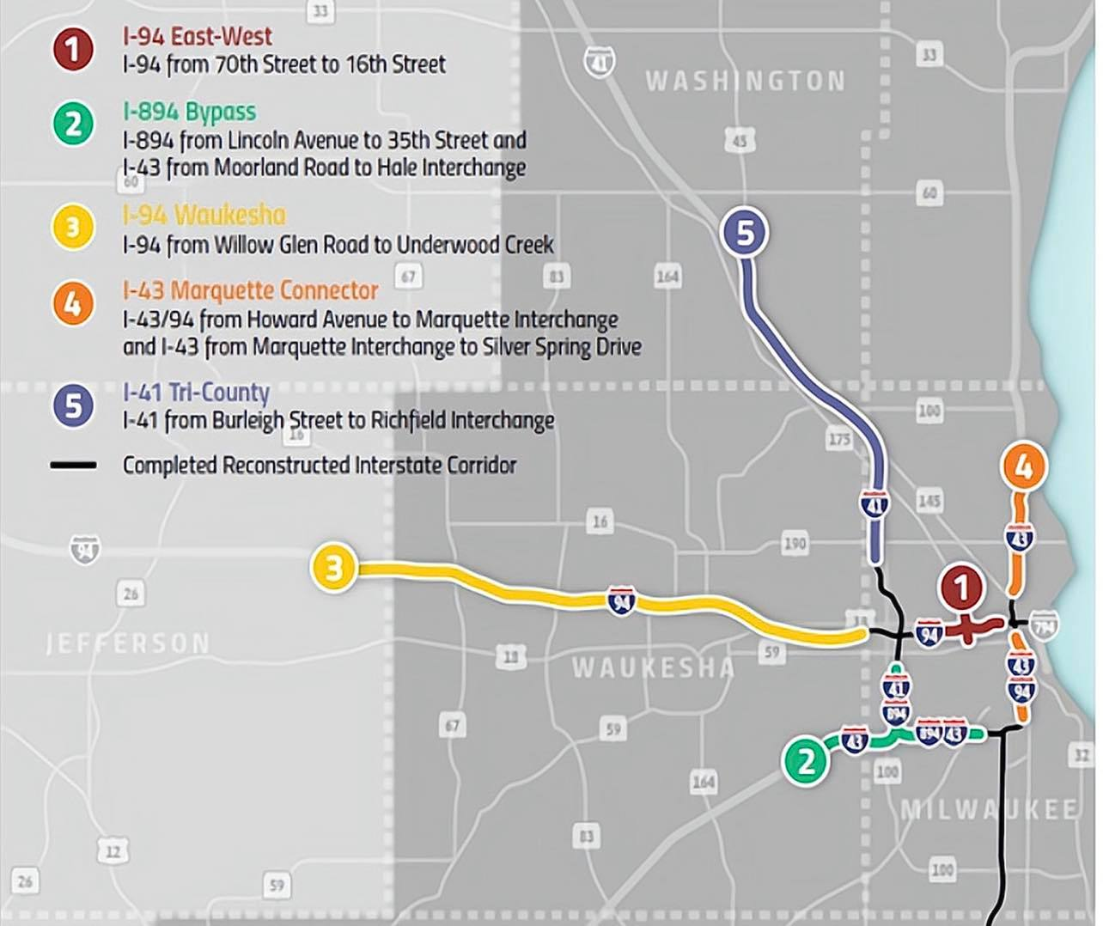
WI Needs a Plan to Reconstruct Key SE Corridors
WisDOT is also evaluating alternatives to reconstruct the I-794 freeway corridor (Lake Interchange), between the Milwaukee River and Hoan Bridge.
Source: Wisconsin Department of Transportation

Slide 30
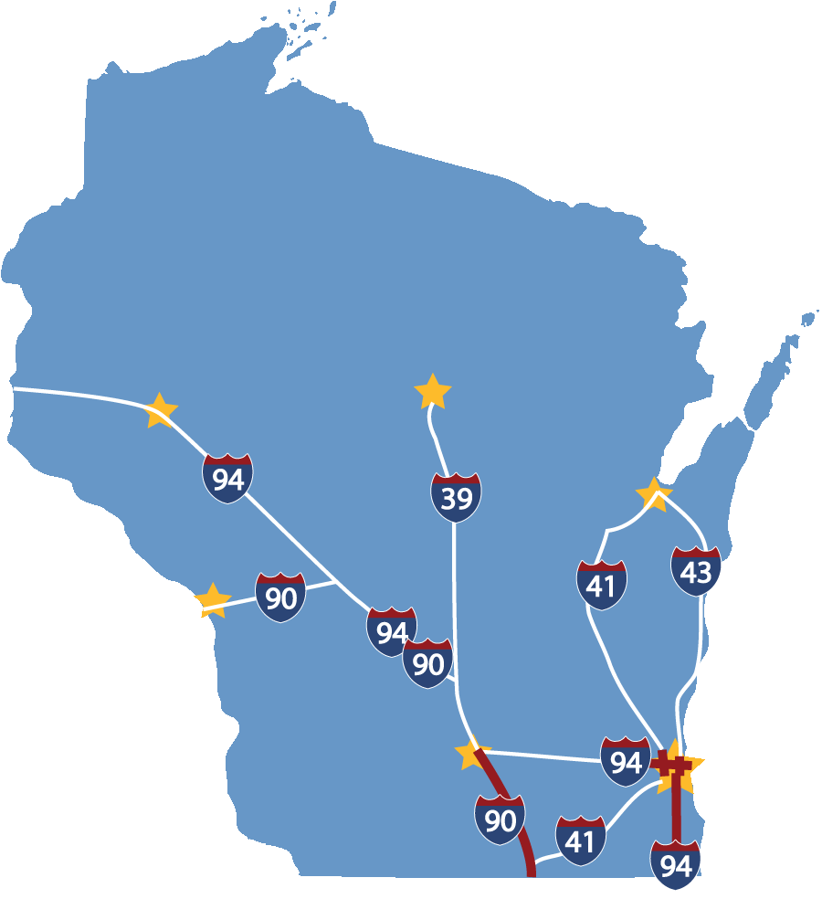
Upgrades for Current Economy and Design Standards Result in Significant Crash Reductions
Zoo Interchange 29%
Marquette Interchange 48%
I-94 N-S 34%
I-39/90 27%
Source: Wisconsin Department of Transportation

Slide 31
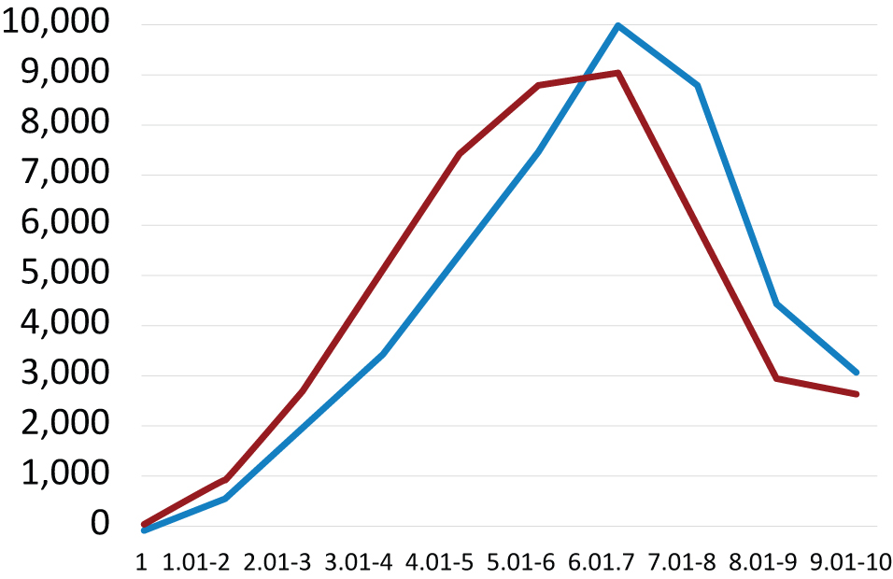
Local Road Conditions Reflect Decades of Disinvestment
2010 Statewide Average: 6.62
2023 Statewide Average: 6:17
Total Mileage
2010
2023
Average Rating
Source: Wisconsin Policy Forum Report – Eyes on the Road: Assessing the quality of Wisconsin’s local roads, Dec. 2024

Slide 32
More than One in Three Wisconsin Bridges Deficient, Marked for Replacement, > 50 Years Old
5,341
WI has identified 2,216 bridge replacements/ repairs (includes structurally deficient), estimated cost of $2 billion.
Many other bridges are over 50 years old.
462 weight-posted bridges, about 90% on local systems.
41%
Graph Source: Federal Highway Administration (FHWA) National Bridge Inventory (NBI), downloaded on Jan. 5, 2025. Structures with spans > 20 ft. *= No reconstruction in the last 10 years.

Slide 33
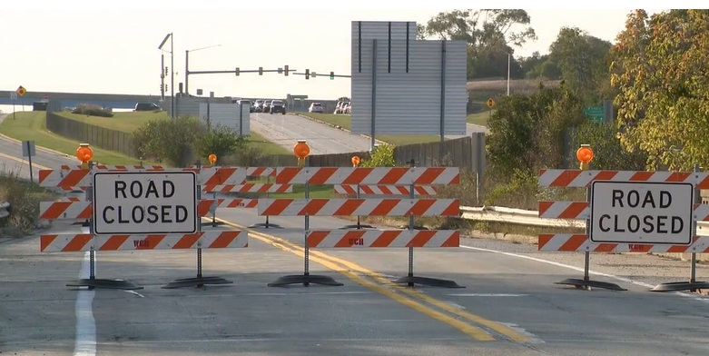
Unexpected Closure of Waukesha County Bridge Highlights Need for Timely Investment
80 year-plus deficient bridge scheduled for replacement in 2027 or 2028 closed in October 2024 due to deterioration.
WisDOT is developing an expedited construction plan to replace the bridge in 2025.

Slide 34
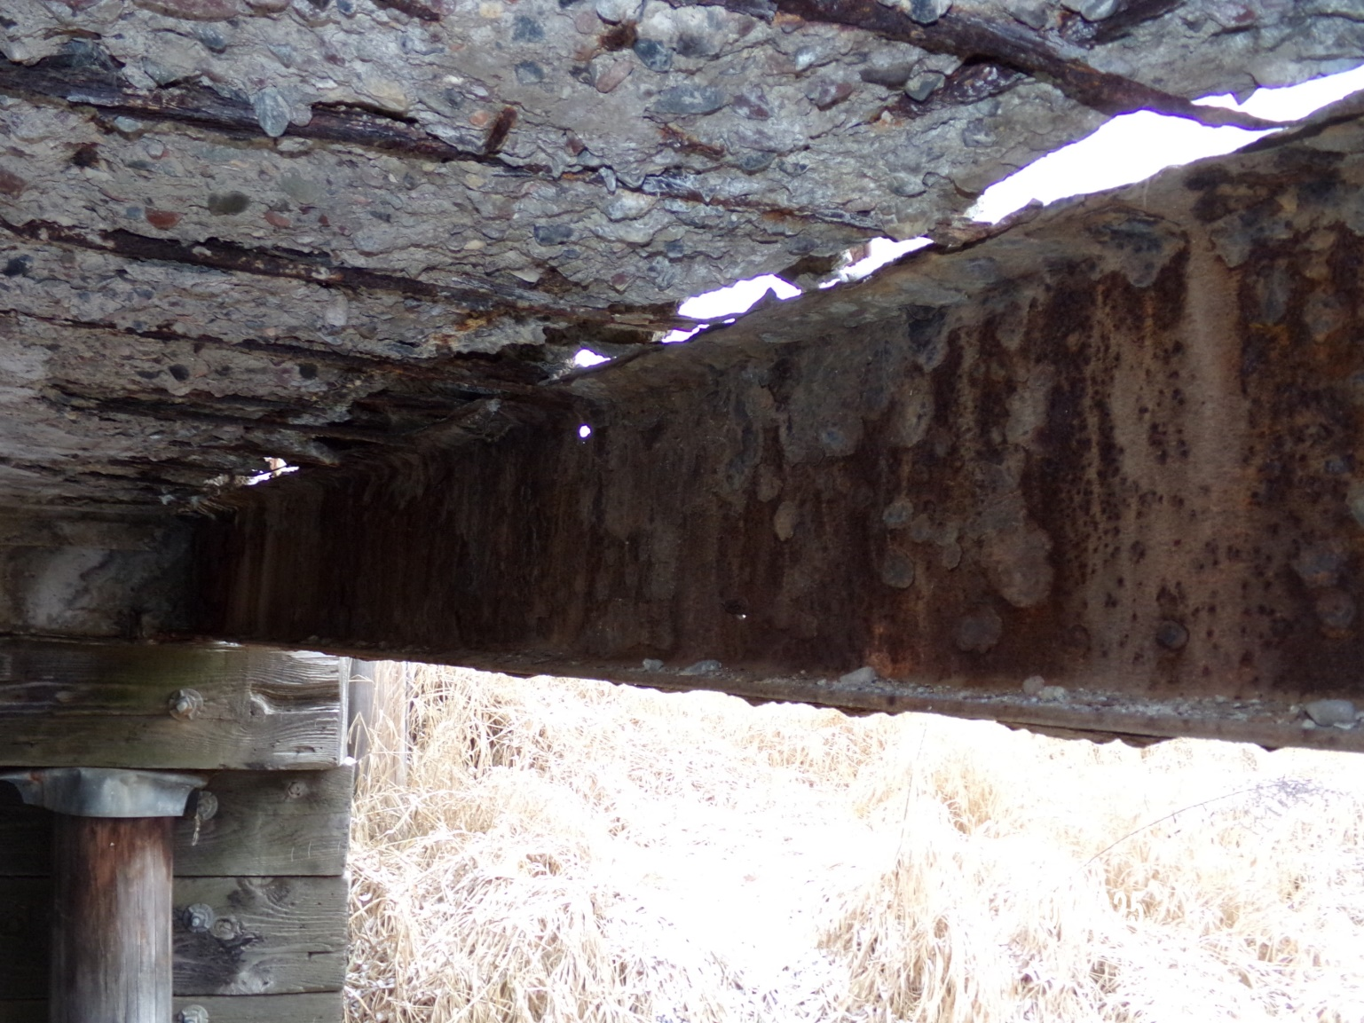

First Inventory for Small Bridges Finds Aging
Structures
2023-25 budget includes $12.5 million for inventorying and assessing structures between 6'-20’.
More than 17k structures identified.
Assessments have begun.

Slide 35
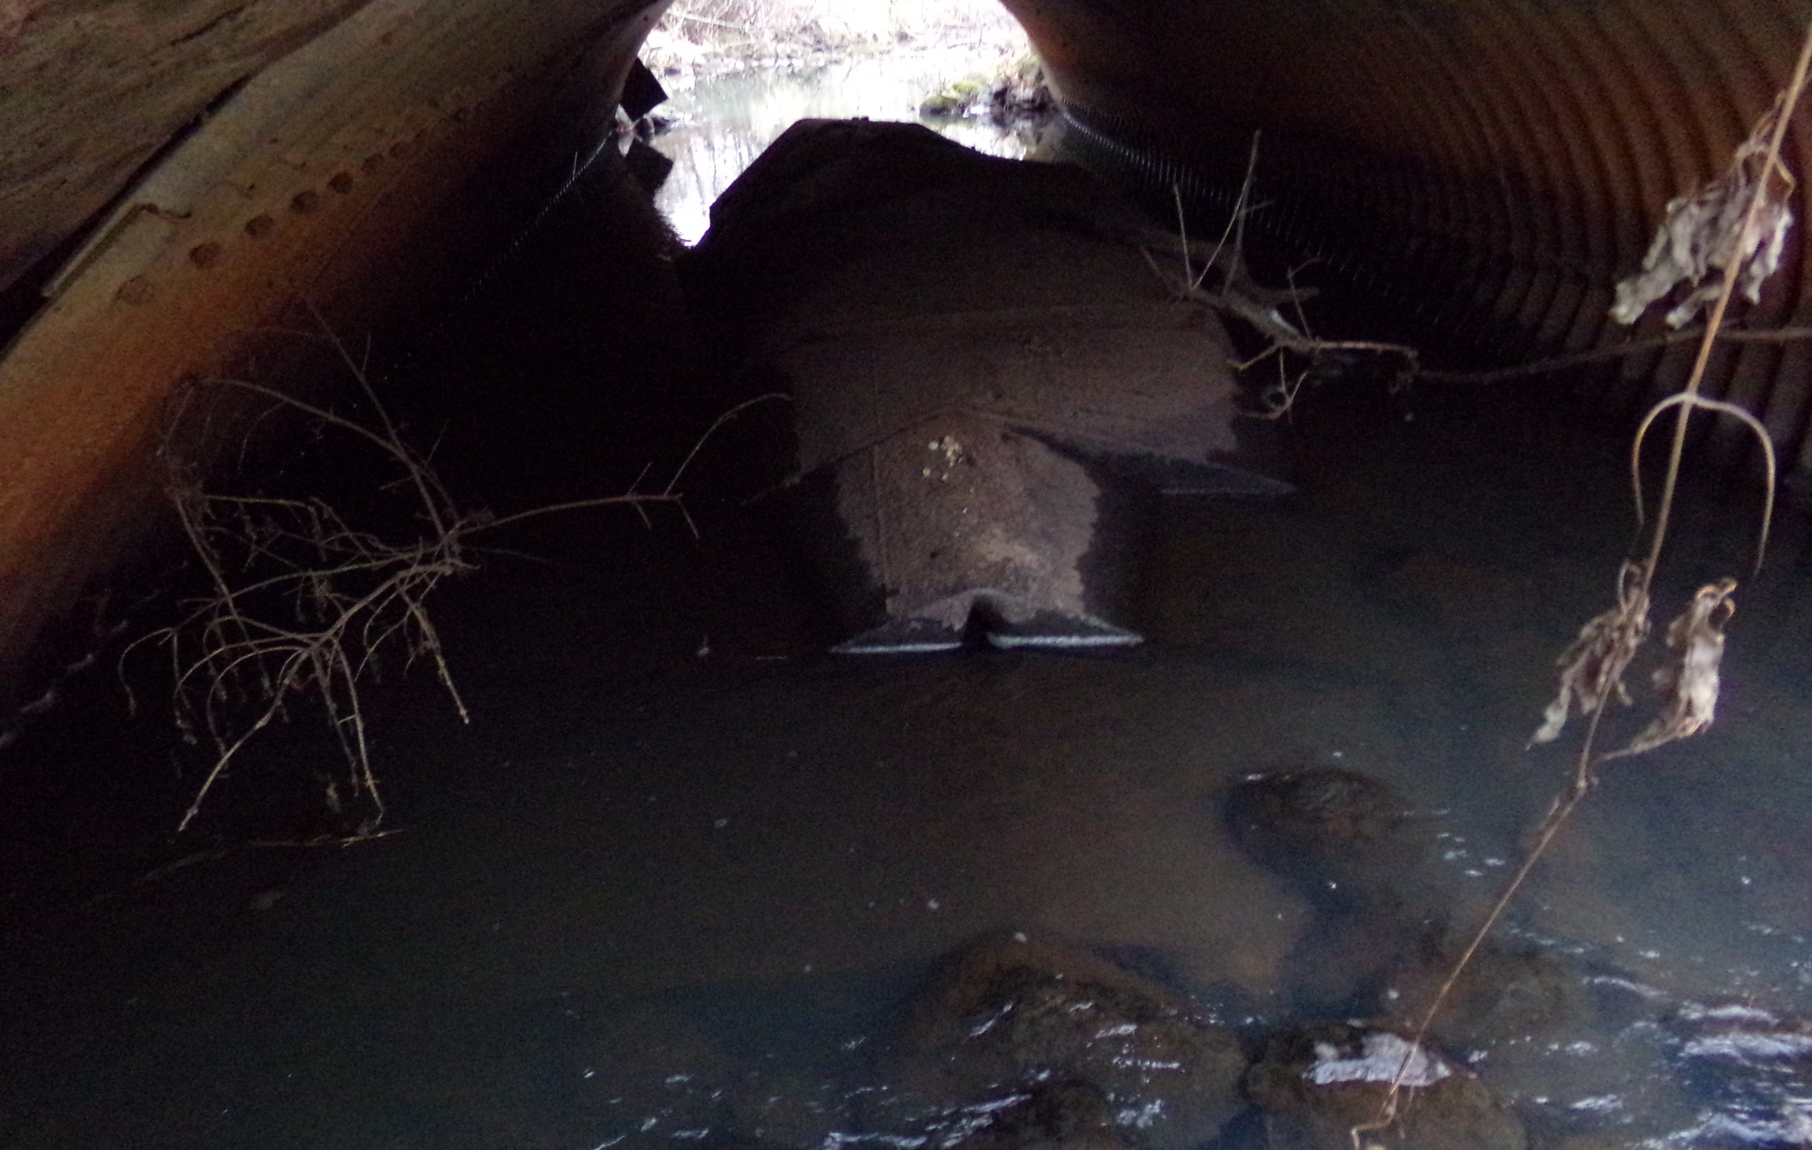
Road Closed After Under 20 Ft Structure Inspection
Barron County Town of Lakeland road closed after inspection. The 152" x 70" plate arch structure carries the Yellow River under 10 1/2 St.
Road serves as a haul route for Cemstone Ready Mix. Used to move washed material from their pit to several of their concrete plants.
Detour could impact the condition of other town roads.
The floor has corroded and failed, deforming until it is above the water.

Slide 36
2025-27 Shortfall Over $1 Billion+
Infrastructure Targets (in Millions $):
Highway Capital Improvement Projects | 2025-2027
I-41 | $585
US 51 Stoughton to McFarland | 123
I-39/90/94 to the Dells | 128
US-51 US 12 to WIS 19 | 13
I-94 East-West | 350
Total | $1,199
Amount Over Base Funding $625 Million
Source: Estimated cost using year of expenditure dollars from February 2025 TPC report or WisDOT.

Slide 37
Shortfall Over $1 Billion & Growing
2025-27 Needs Over Base Funding
Majors/SE Megas $625 Million
Local Capital Assistance (LRIP-S & ARIP) $250 Million
Maintain SHR & Other Program Purchasing Power $350 Million +
Estimated Shortfall: $1.2 Billion +

Slide 38
Without Long-Term Fixes, Structural Shortfalls Return and Grow
$1 billion/year shortfall was well-documented by multiple reports, but it doesn’t reflect all Wisconsin’s evolving needs .
Wisconsin made progress in the 2019-21 & 2023-25 budgets budget, but fixed flat fees and one-time funding don’t keep up with inflation and structural deficits.
An influx of funds from the federal infrastructure law helped but didn’t solve the long-term Trust Fund challenges. Surface reauthorization expires in 2026, with ongoing funding uncertain.
Using Wisconsin Construction Cost Index: actual for past, 10-year avg. for future.
2019-21: $230 million/year ongoing revenue, $90 million non-recurring.
2021-23: Highway/bridge federal Infrastructure law dollars (Est. $290 million/year) & non-recurring funding to offset pandemic-induced state revenue declines.
2023-25: $57.2 million/year ongoing growing revenue, $113 annually freed up from transit out of GF, $555.5 million non-recurring. Growth of sales tax on EVs is assumed to offset loss of gas tax revenues in the short-term.

Slide 39
How Other States Fund Transportation

Slide 40
Neighbors Have More & Growing User Fee Options
State | Fuel Tax | Fuel Sales Tax (1) | Fuel Tax Indexing | Vehicle Reg. Fee | New Vehicle Fee | Bonding | Toll Roads/ Bridges | Delivery Fees | General Funds
Illinois | X | X (2) | X | X |  | X | X |  | X
Indiana | X | X | X | X |  | X | X |  | X
Iowa | X |  |  | X | X (4)
Michigan | X | X (3) | X | X |  | X | X |  | X
Minnesota | X |  | X | X | X (5) | X | X | X | X
Wisconsin | X |  |  | X |  | X |  |  | X
A cents-per-gallon equivalent.
Beginning in 2021, revenue incrementally moves over a 5-year period to the Road Fund.
A % of fuel sales tax and sales tax on autos and related parts is used to fund public transit.
There is no sales tax on auto purchases, but a 5% new car reg. fee.
Sales tax on auto sales goes toward transportation.

Slide 41
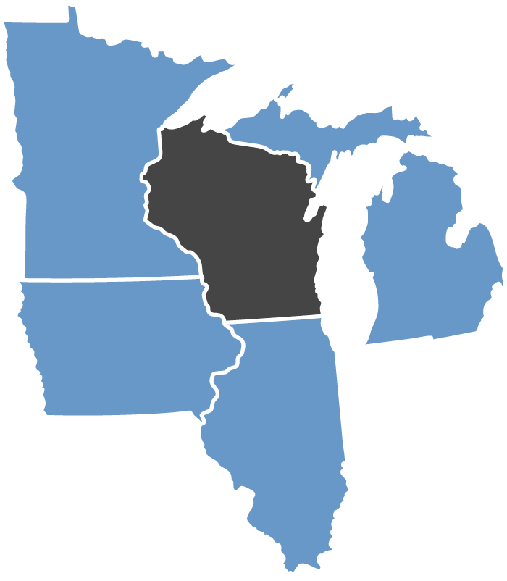
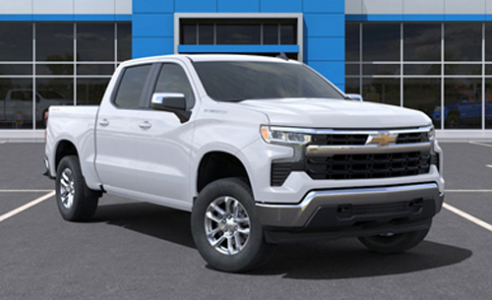
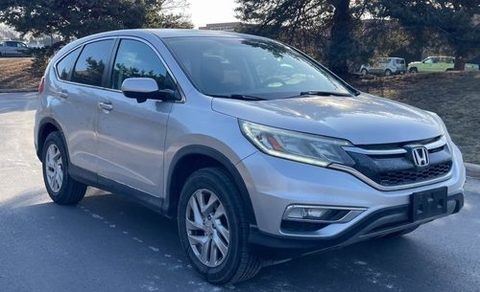
It’s Cheaper to Drive in Wisconsin, Even in Madison
The cost for Wisconsin motorists to own and drive vehicles is the lowest in the Midwest in most cases. The exception is older vehicles, as MN’s value-based tab fees drop 5-15% yearly for the first 10 years of ownership.
$1,094
$202
$401
$295
$625
$330
$779
$416
$879
$554
2024 Chevy Silverado
2015 Honda CRV
Source: WisDOT Midwest Driver Fee Calculator, 12k miles, Dane County, Madison

Slide 42
Funding Trends

Slide 43
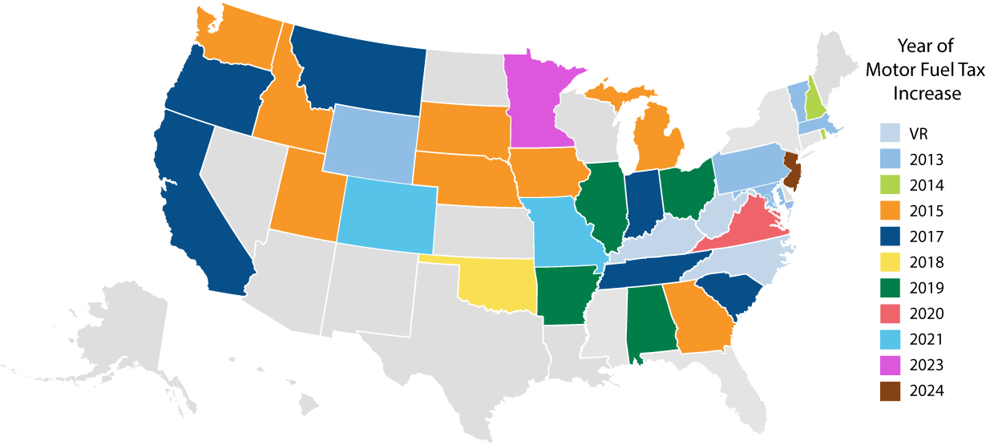
34 States Legislatively Adjust State Motor Fuel Taxes
2013 - 2025
52.8
33.8
31.7
31.4
40
23
31.9
23.8
33
30
32.9
32.6
27.5
24
25
47.8
38.1
23.8
31.3
30
58.7
45
39.2
66.1
52.5
38.5
23
69.8
28.2
35.7
46.3
25
27.5
40.4
27.8
27.4
40.6
19
20
18.9
25
28.8
9
18.4
30.2
33.9
20
20.9
39.4
18.5
Source: American Road & Transportation Builders, Transportation Investment Advocacy Center. All fees and taxes on gas, including sales tax, even if it doesn’t benefit transportation.

Slide 44
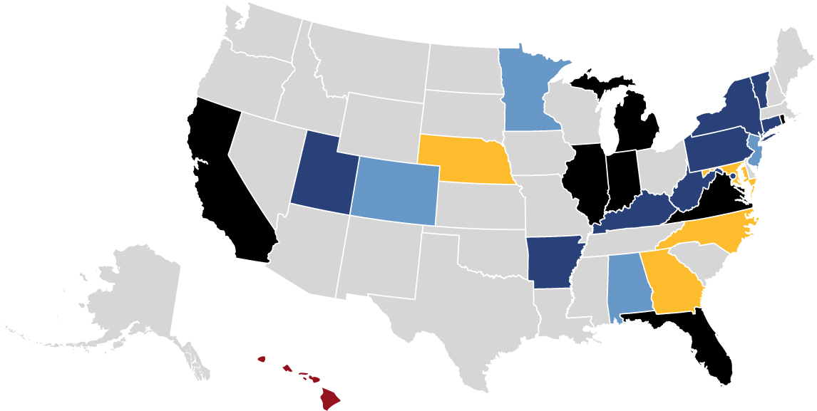
24 States & DC Use Variable-Rate State Gas Taxes
Changes in Inflation
Average Wholesale Price
State Sales Tax Applies
Combination
Other
No Variable-Rate Gas Tax
Source: American Road & Transportation Builders, Transportation Investment Advocacy Center, July 2023
Notes:
https://transportationinvestment.org/research/funding-techniques/variable-rate-state-motor-fuel-taxes/

Slide 45







Types of Variable-Rate State Gas Taxes
Consumer Price Index
10 States
Average Wholesale Price of Fuel
10 States + DC
Meeting State’s Transportation Fund Needs
2 States
Changing Population
1 States
Corporate Average Fuel Economy
1 State
National/Local Highway Construction Cost Index
3 States
General Sales Tax on Fuel Purchases
4 States
Source: American Road & Transportation Builders, Transportation Investment Advocacy Center, July 2023

Slide 46
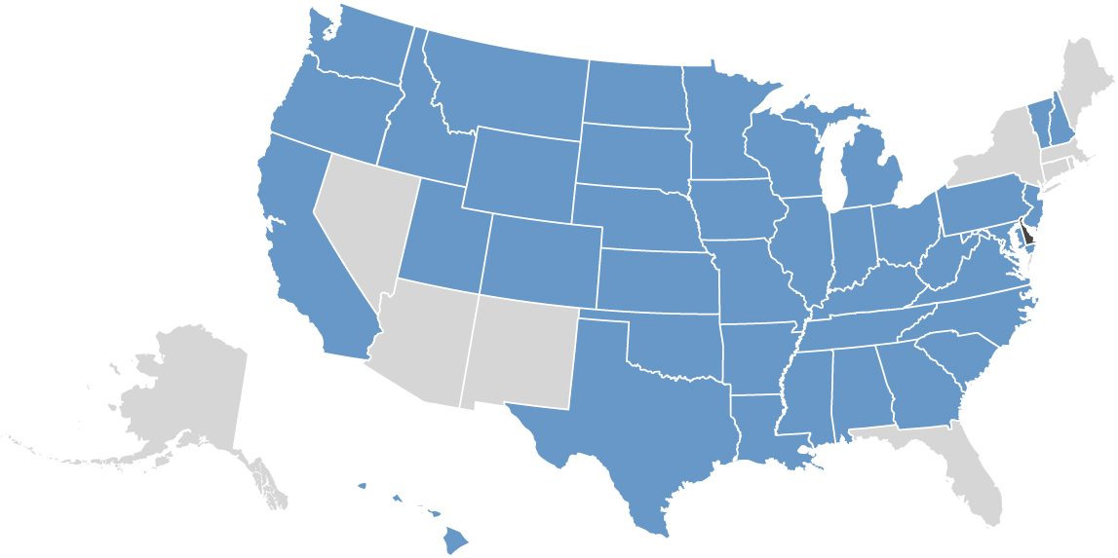
39 States Have an Electric Vehicle Registration Fee
EV fees run from $50 in Colorado to a high of $290 in New Jersey in 2028.
Source: American Road & Transportation Builders, Transportation Investment Advocacy Center, Jan. 2025
Notes:
https://transportationinvestment.org/wp-content/uploads/2024/08/State_Electric_Vehicle_Fees_Aug_2024.pdf

Slide 47
8 State Have Electric Vehicle Charging Station Fees
Kilowatt-hour (kWh) fees on public charging stations is a way to make sure visitors driving electric vehicle pay to use Wisconsin’s roads.
Source: American Road & Transportation Builders, Transportation Investment Advocacy Center, April 2024
Notes:
https://transportationinvestment.org/wp-content/uploads/2024/04/EV_Charging_Station_Fees_April_2024.pdf

Slide 48
Two States Have Enacted a Retail Delivery Fee
Colorado: 2021
A flat $0.29 (current rate) on certain deliveries with at least one item of tangible personal property subject to state sales or use tax, adjusts annually based on inflation.
Collected Revenue: $84.9 million in FY 2023-2024.
Minnesota: 2023
A flat $0.50 fee on select retail sales transactions over $100, collected by the retailer.
Expected Revenue: $65.3 million in Fiscal Year 2027
Taxes or fees on retail deliveries ensure delivery vehicles, which are often heavier, make frequent trips, and put additional wear and tear on roads and bridges, contribute to infrastructure maintenance and improvements
Source: American Road & Transportation Builders, Transportation Investment Advocacy Center, April 2023
Notes:
https://transportationinvestment.org/wp-content/uploads/2023/10/Retail_Package_Delivery_Fees.pdf

Slide 49
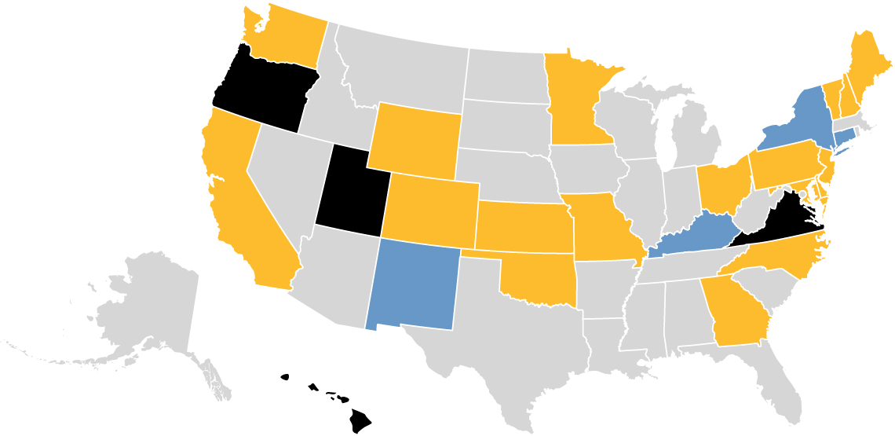
Four State Have Active Road User Charge Programs
Other states have studied charging by vehicle miles traveled.
Optional Program
Weight/Distance Fee –
Commercial
State Pilot, Study or Research
Source: American Road & Transportation Builders, Transportation Investment Advocacy Center, 2024
Notes:
https://transportationinvestment.org/wp-content/uploads/2024/01/Road_Usage_2024.pdf

Slide 50
Options to Consider

Slide 51
It’s Time to Evaluate the Options
X Fuel-based options
X VMT
(low tech)
X VMT
(high tech)
X Sales tax on autos, & auto parts
X Weight/value/efficiency-based registration fee
X Right of way fees
Revenue Generating Ability
$100 Million
Per Year
X Retail delivery fees
X Tolling
Time to Implement

