Slide 1
The State of Wisconsin Transportation
January 2026
1.15.2026

Slide 2
Wisconsin’s Transportation-Dependent Economy
Transportation-Dependent Industries Critical for Wisconsin
Employment & Wage Shares, Manufacturing, Trucking, Agriculture, & Mining, WI & US, 2023
2

Slide 3
Wisconsin’s Transportation-Dependent Economy
Investment is Not Keeping Up with the Economy
Transportation Spending
GDP
2000-2024 | In Millions
Before 2017, annual transportation spending was about 1% of GDP.
3

Slide 4
How Wisconsin Funds Transportation
4

Slide 5
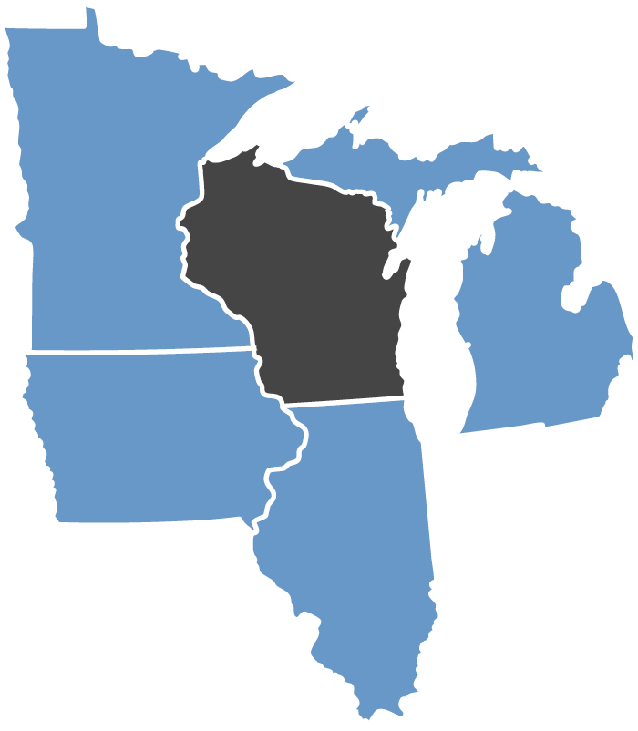
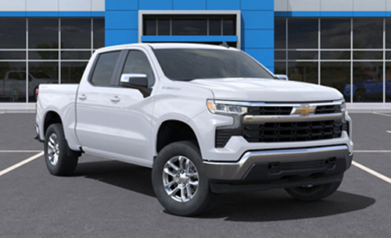
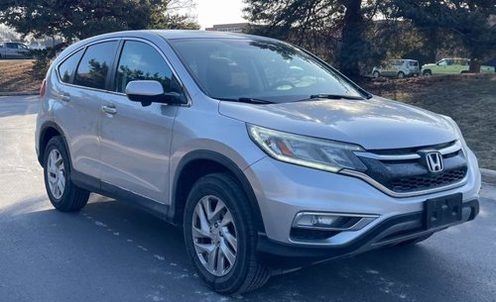
How Wisconsin Funds Transportation
It’s Cheaper to Drive in Wisconsin, Even in Madison
The cost for Wisconsin motorists to own and drive vehicles is the lowest in the Midwest in most cases. The exception is older vehicles, as MN’s value-based tab fees drop 5-15% yearly for the first 10 years of ownership.
$1,094
$202
31.8 CPG
(1)
31.8 CPG
(1)
$401
$295
30.9 CPG
$635
30.9 CPG
$330
$779
51.0 CPG
(1)(3)
$416
51.0 CPG
(1)(3)
30.0 CPG
$879
30.0 CPG
$554
48.3 CPG
(1)(2)
48.3 CPG
(1)(2)
2024 Chevy Silverado
2015 Honda CRV
Annual adjustment to maintain purchasing power.
State also charges sales tax on gas. Est. rate including sales tax: +17 CPG IL.
Effective 1/1/2026 Michigan’s 6% sales tax on gas becomes a 20-cent increase to the excise tax (reflected above).
5

Slide 6
How Wisconsin Funds Transportation
Transportation User Fees Don’t Grow Like General Fund Taxes
IN MILLIONS
General Fund tax collections in 2024 dollars (CPI) increased 14%, despite tax cuts, with growing incomes, prices, and consumer spending buoying the fund.
Transportation user fee revenue (in 2024 $s, WCCI) decreased 32% despite some fee increases.
14%
-32%
6

Slide 7
How Wisconsin Funds Transportation
Percentage of Out-of-State Contribution Drops by More Than 30%
% of Total State Transportation Revenue
Est. % Out-of-State Contribution
Declining Out-of-State Contribution
7

Slide 8
Where the Money Goes
8

Slide 9
Where the Money Goes
Majority of Highway Spending Aimed at Maintaining Highway Conditions
9

Slide 10
Where the Money Goes
Wisconsin’s Highway Construction Costs Lower Than National Average, Most Neighbors (In 2015 Constant Dollars)
10

Slide 11
Where the Money Goes
Current Highway and Local Spending Declines in Real Dollars
State Highways
IN BILLIONS $
Spending by area, three-year rolling average, 1994 to 2027, inflation adjusted to 2023 dollars using CPI.
11

Slide 12
System Conditions
12

Slide 13
System Conditions
Real Major Highway Funding Lower Than 25 Years Ago
IN MILLIONS, 2000 $s using Wis. Construction Cost Index
13

Slide 14
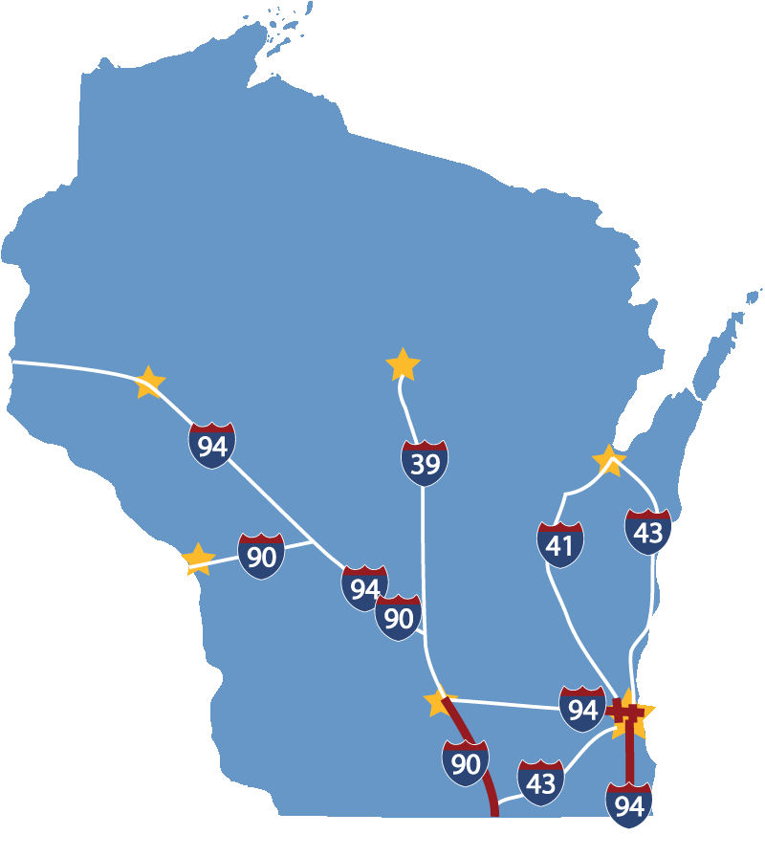
System Conditions
Upgrades for Current Economy and Design Standards Result in Significant Crash Reductions
Zoo Interchange 29%
Marquette Interchange 48%
I-94 N-S 34%
I-39/90 27%
14

Slide 15
System Conditions
One in Three Bridges Deficient, Marked for Replacement, > 50 Years Old
5,358
WI has identified 1,744 bridge replacements/ repairs (includes those rated poor), estimated cost of $2 billion.
Many other bridges are over 50 years old.
468 weight-posted bridges, about 90% on local systems.
39%
*With no major work in the last decade.
15

Slide 16
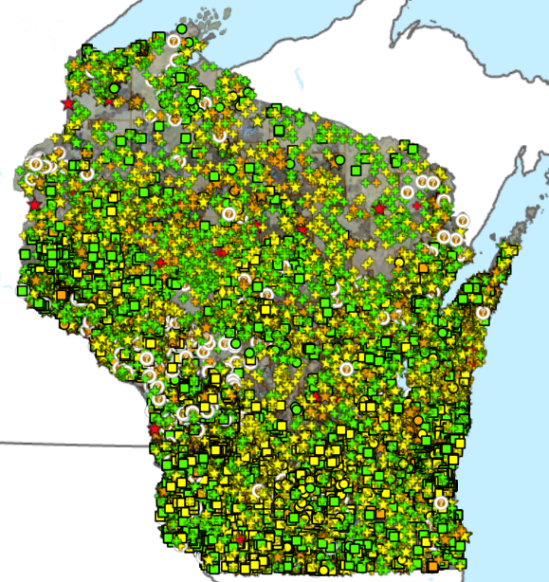
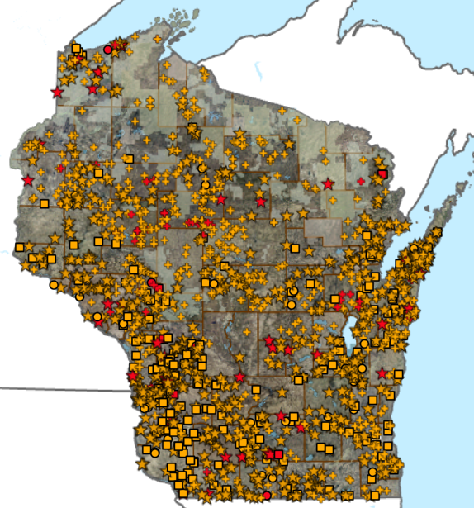
System Conditions
Small Bridges (6-20’): The Progress We’ve Made, The Work to Do
Nearly 17,000 Structures Inventoried
1,600+ Poor/Severe Structures
16

Slide 17
Conclusion
17

Slide 18
Conclusion
2027-29 Shortfall of More Than $1 Billion
Infrastructure Targets (in Millions $):
Highway Capital Improvement Projects | 2027-2029
I-41 | $209
US 51 Stoughton to McFarland | 47
I-39/90/94 to the Dells | 500
US-51 US 12 to WIS 19 | 12
I-94 East-West | 499
Total | $1,267
Amount Over Base Funding (excluding bonding) $560 Million
Local Capital Assistance (LRIP-S & ARIP) $250 Million
One-Time GPR Less One-Time Uses Including LRIP/ARIP $295 Million
Maintain SHR & Other Program Purchasing Power $200 Million+
Estimated Shortfall: $1.3 Billion+
18

Slide 19
Conclusion
Without Long-Term Fixes, Structural Shortfalls Return and Grow
$1 billion/year shortfall was well-documented by multiple reports, but it doesn’t reflect all Wisconsin’s evolving needs.
Wisconsin made progress in the 2019-21, 2023-25, & 2025-27 budgets, but fixed flat fees and one-time funding don’t keep up with inflation and structural deficits.
An influx of funds from the federal infrastructure law helped but didn’t solve the long-term Trust Fund challenges. Surface reauthorization expires in 2026, with ongoing funding uncertain.
19

