Slide 1
The State of Wisconsin Transportation
February 2026
2.17.2026

Slide 2
Wisconsin’s Transportation-Dependent Economy
Transportation-Dependent Industries Critical for Wisconsin
Employment & Wage Shares, Manufacturing, Trucking, Agriculture, & Mining, WI & US, 2023
2

Slide 3
Wisconsin’s Transportation-Dependent Economy
More Transportation-Dependent Than Neighbors, US Avg.
Transportation-Dependent Sectors, 2023
Employment
Wages
3

Slide 4
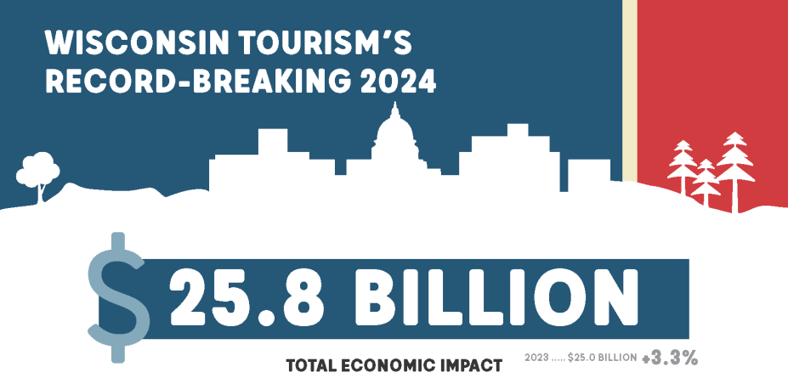
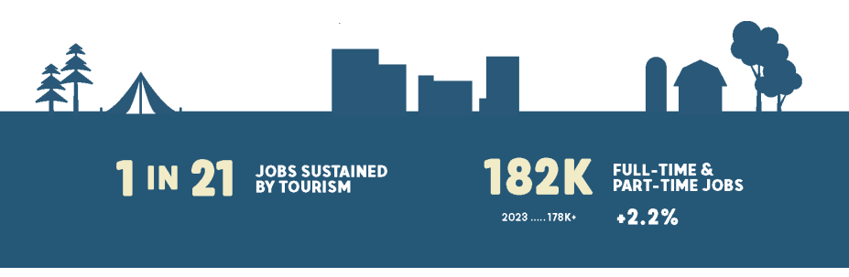
Wisconsin’s Transportation-Dependent Economy Over 100 Million Tourism Visits Each Year
114 million visits generate $16.3 billion in direct visitor spending, resulting in:
  $1.7 billion in state and local taxes.
  $1.4 billion in federal taxes.
Each Wisconsin household would need to pay $678 in taxes to maintain the current level of government services generated by tourism spending.
4

Slide 5
Wisconsin’s Transportation-Dependent Economy
Investment is Not Keeping Up with the Economy
Transportation Spending
GDP
2000-2024 | In Millions
Before 2017, annual transportation spending was about 1% of GDP.
5

Slide 6
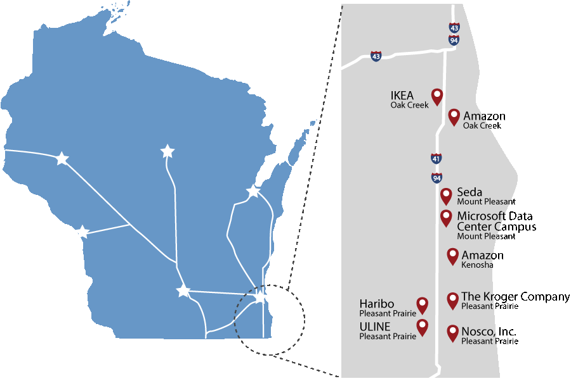
Wisconsin’s Transportation-Dependent Economy
Case Study: Business Booms Along Improved I-94 N-S
$2 billion investment = $11 billion (108%) increase in assessed property values along the corridor since 2015, compared to 30% in the rest of Milwaukee, Kenosha, and Racine counties.
6

Slide 7
How Wisconsin Funds Transportation
7

Slide 8
How Wisconsin Funds Transportation
All Funds Budget Overview of Revenue (2025-27)
39% Gas Tax
39% Reg. & Title Fees
11% Non-recurring GPR Transfer
11% Other State Funds
8

Slide 9
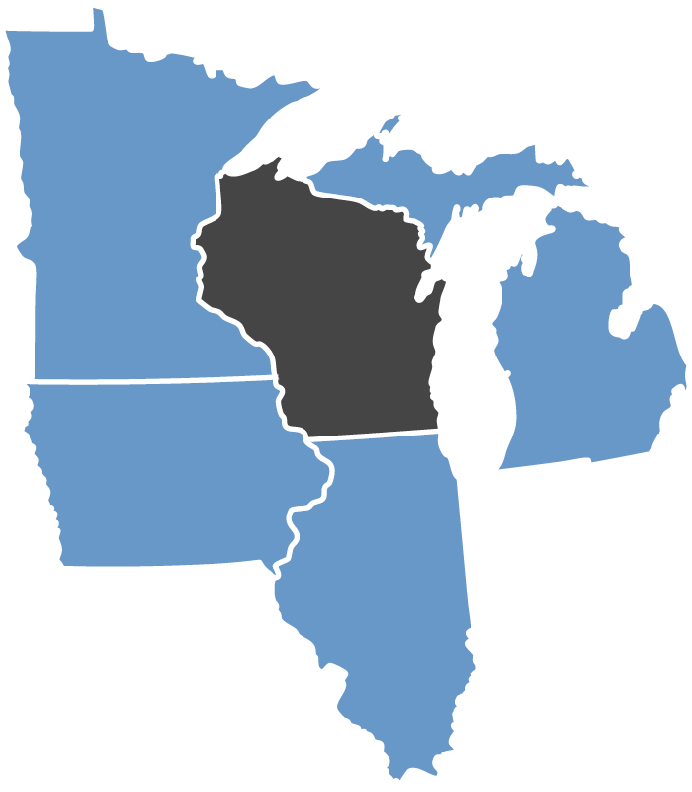
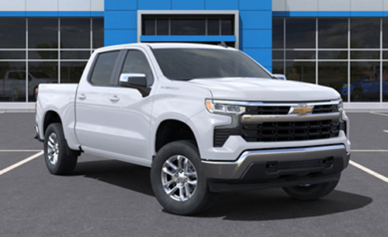
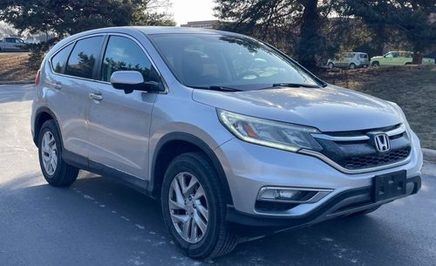
How Wisconsin Funds Transportation
It’s Cheaper to Drive in Wisconsin, Even in Madison
The cost for Wisconsin motorists to own and drive vehicles is the lowest in the Midwest in most cases. The exception is older vehicles, as MN’s value-based tab fees drop 5-15% yearly for the first 10 years of ownership.
$1,094
$202
31.8 CPG
(1)
31.8 CPG
(1)
$401
$295
30.9 CPG
$635
30.9 CPG
$330
$779
51.0 CPG
(1)(3)
$416
51.0 CPG
(1)(3)
30.0 CPG
$879
30.0 CPG
$554
48.3 CPG
(1)(2)
48.3 CPG
(1)(2)
2024 Chevy Silverado
2015 Honda CRV
Annual adjustment to maintain purchasing power.
State also charges sales tax on gas. Est. rate including sales tax: +17 CPG IL.
Effective 1/1/2026 Michigan’s 6% sales tax on gas becomes a 20-cent increase to the excise tax (reflected above).
9

Slide 10
How Wisconsin Funds Transportation
Transportation User Fees Don’t Grow Like General Fund Taxes
IN MILLIONS
General Fund tax collections in 2024 dollars (CPI) increased 14%, despite tax cuts, with growing incomes, prices, and consumer spending buoying the fund.
Transportation user fee revenue (in 2024 $s, WCCI) decreased 32% despite some fee increases.
14%
-32%
10

Slide 11
How Wisconsin Funds Transportation
Inflation Adjusted Transportation Revenue Lower Than 2000
IN BILLIONS $
Total transportation revenue by fiscal year 1994 to 2025, adjusted to 2023 dollars (CPI)

Slide 12
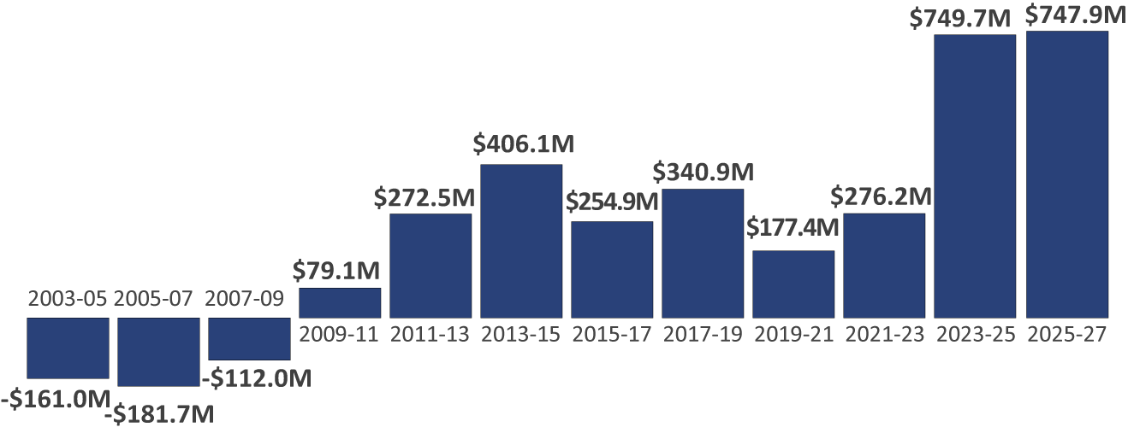
How Wisconsin Funds Transportation
Wisconsin Increasingly Relies on General Fund Revenue
Revenues transferred from the transportation fund to the general fund
Dollars from the general fund to the transportation fund
Transfers don’t include transit funding paid directly from the General Fund ($228.7 in 2023-25, $232.3 in 2025-27) or GF debt service.
12

Slide 13
How Wisconsin Funds Transportation
State Gas Tax has Not Kept Pace with Inflation Since 2006
Gas Tax
2006: Gas Tax Indexing Ends
IN BILLIONS $
2026: $50 Title Fee
Increase
Driver’s License & Other Revenue
General Tax Revenue
Major state transportation fund revenue sources, state fiscal years, adjusted for inflation to 2023 dollars (CPI)
13

Slide 14
How Wisconsin Funds Transportation
Gas Tax Purchasing Power Declines, Construction Inflation Outpacing CPI
$1.00
CPI:>35% decrease in purchasing power
$0.64
$0.49
Wis. Construction Cost Index: 50+%
14

Slide 15
How Wisconsin Funds Transportation
Construction Inflation Reduces Number of Road Improvement Projects
$100 Million Investment (in 2004 constant dollars using CPI)
Despite Investment levels staying constant (CPI),the number of miles reconstructed declines as Wisconsin Construction Inflation outpaces CPI.
Miles Reconstructed
15

Slide 16
How Wisconsin Funds Transportation
Motorists Are Paying Less in Gas Tax
Average fuel efficiency increased from 20.3 MPG in 2006 to 25.4 MPG in 2025.
Motorists driving 12,000 miles/year buys 118.7 fewer gallons than in 2006.
And pays $36.68 less in today’s dollars.
Compared to
$55.89
More on a $100 market basket of goods and services
$36.68
Less Gas Tax Paid
16

Slide 17
How Wisconsin Funds Transportation
Fuel-Efficient Vehicles Equal Gas Tax Break
Fuel Efficiency’s Gas Tax Cut
The 25% increase in fuel economy since 2006 results in reduction for the average motorist equal to about 7.8 cents per gallon.
Or an estimated $267 million in gas tax revenue annually.
7.8¢
per gallon
17

Slide 18
How Wisconsin Funds Transportation
Gas Powered Vehicles Are Not Going Away Soon
Registered Hybrid and EV Percentages of
Wisconsin Passenger Vehicle Fleet
Nearly 97%
of Wisconsin’s 4.8M passenger vehicle fleet are non-hybrid, gas-powered vehicles.
2.67%
0.48%
18

Slide 19
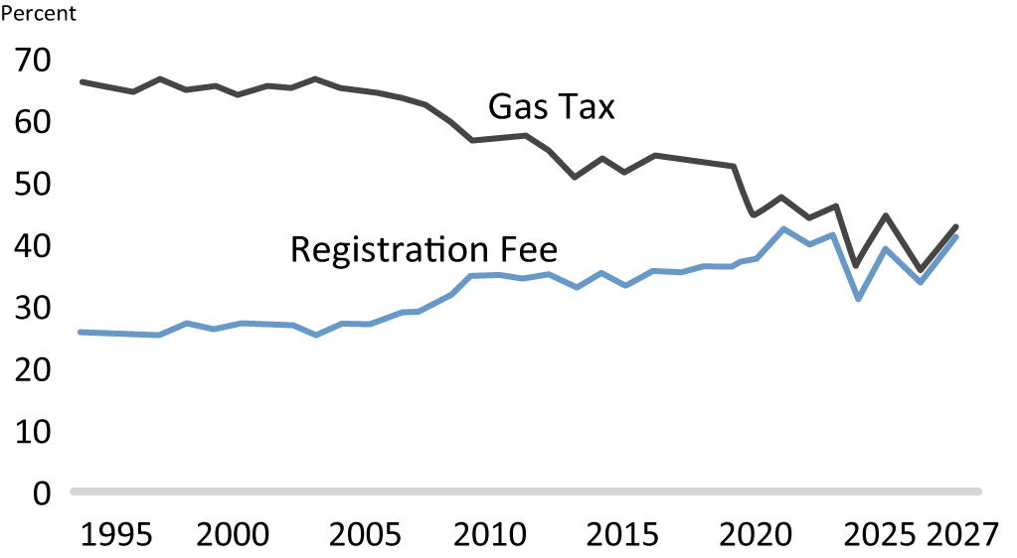
How Wisconsin Funds Transportation
Registration Fee Revenue Now Rivals Gas Tax
19

Slide 20
How Wisconsin Funds Transportation
Percentage of Out-of-State Contribution Drops by More Than 30%
% of Total State Transportation Revenue
Est. % Out-of-State Contribution
Declining Out-of-State Contribution
20
Notes:
https://www.politifact.com/factchecks/2019/jun/28/jon-erpenbach/state-lawmakers-gas-tax-claim-gets-green-light/

Slide 21
How Wisconsin Funds Transportation
Wisconsin Bends Debt Service Trend, Work Still To Do
IN MILLIONS
21

Slide 22
Where the Money Goes
22

Slide 23
Where the Money Goes
All Funds Budget Overview of Spending (2025-27)
23

Slide 24
Where the Money Goes
Majority of Highway Spending Aimed at Maintaining Highway Conditions
24

Slide 25
Where the Money Goes
Local Funding Split Between Capital & Operations
Local Program Detail
25

Slide 26
Where the Money Goes
Current Highway and Local Spending Declines in Real Dollars
State Highways
IN BILLIONS $
Spending by area, three-year rolling average, 1994 to 2027, inflation adjusted to 2023 dollars using CPI.
26

Slide 27
Where the Money Goes
Wisconsin’s Highway Construction Costs Lower Than National Average, Most Neighbors (In 2015 Constant Dollars)
27

Slide 28
System Conditions
28

Slide 29
System Conditions
Highway Conditions Stabilize, Unsustainable with Current Funding
Conditions stabilized with significant increases in State Highway Rehabilitation funding since the 2017-19 biennium.
Without increasing SHR funding, WisDOT will not be able to maintain program purchasing power and conditions will decline.
WisDOT
Target
29

Slide 30
System Conditions
Real Major Highway Funding Lower Than 25 Years Ago
IN MILLIONS, 2000 $s using Wis. Construction Cost Index
30

Slide 31
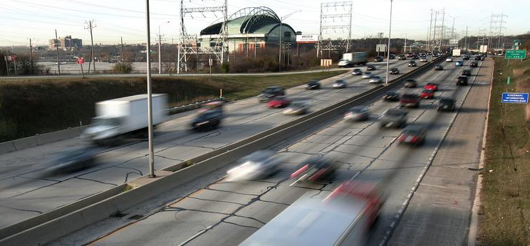
System Conditions
I-94 East-West Next SE Project
60-year-old roadway links updated Zoo and Marquette interchanges
27% of jobs and 35% of businesses in the 7-county region are within five miles of the Stadium Interchange
Project addresses all the corridor’s known issues, specifically severe congestion and related safety challenges
Construction started on the $1.76 billion (year of expenditure $s) project in late 2025
Average of about $400 million per biennium will be needed over the next 3 budgets, $200 million+ in SFY 2032
Any delay will add millions to the cost ($700 million+ since 2017 turnback of ROD)
31

Slide 32
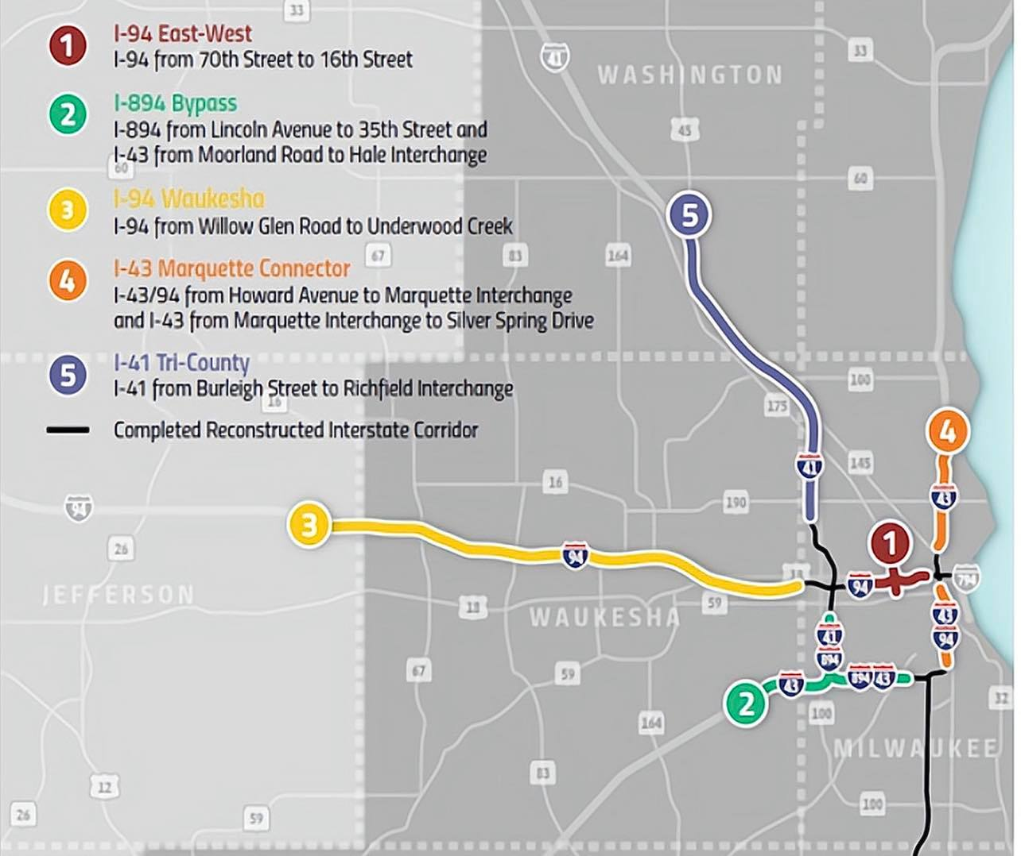
System Conditions
Wisconsin Needs a Plan to Reconstruct Key SE Corridors
WisDOT is also evaluating alternatives to reconstruct the I-794 freeway corridor (Lake Interchange), between the Milwaukee River and Hoan Bridge.
32

Slide 33
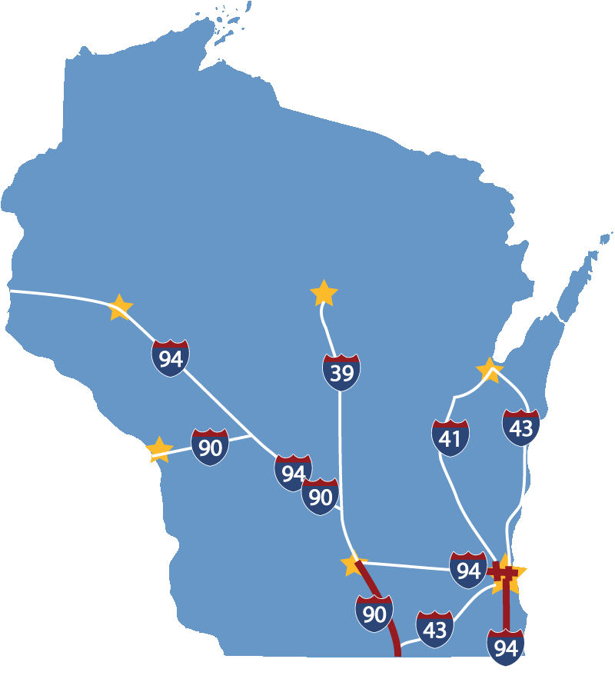
System Conditions
Upgrades for Current Economy and Design Standards Result in Significant Crash Reductions
Zoo Interchange 29%
Marquette Interchange 48%
I-94 N-S 34%
I-39/90 27%
33

Slide 34
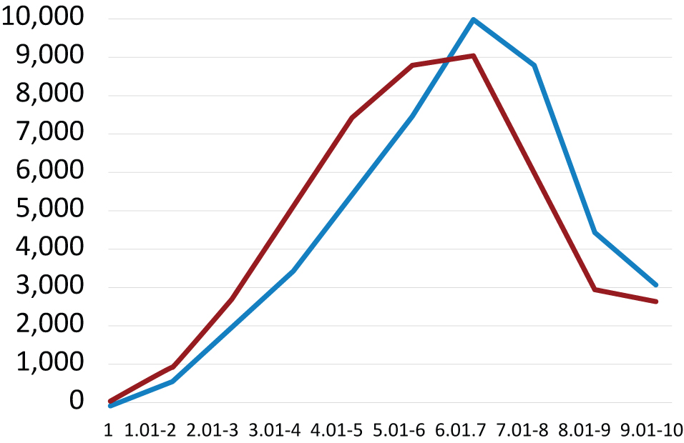
System Conditions
Local Road Conditions Reflect Decades of Disinvestment
2010 Statewide Average: 6.62
2023 Statewide Average: 6:17
Total Mileage
2010
2023
Average Rating
34

Slide 35
System Conditions
One in Three Bridges Deficient, Marked for Replacement, > 50 Years Old
5,358
WI has identified 1,744 bridge replacements/ repairs (includes those rated poor), estimated cost of $2 billion.
Many other bridges are over 50 years old.
468 weight-posted bridges, about 90% on local systems.
39%
*With no major work in the last decade.
35

Slide 36
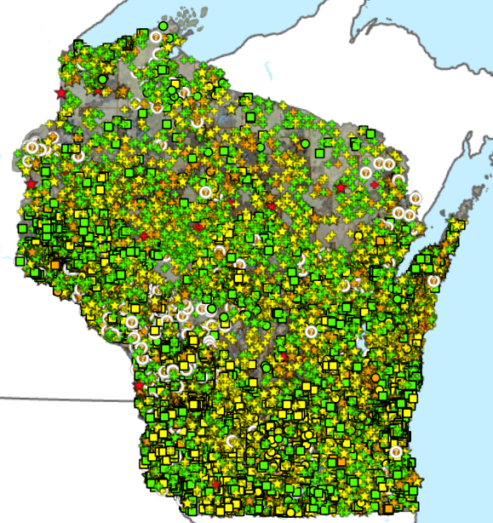
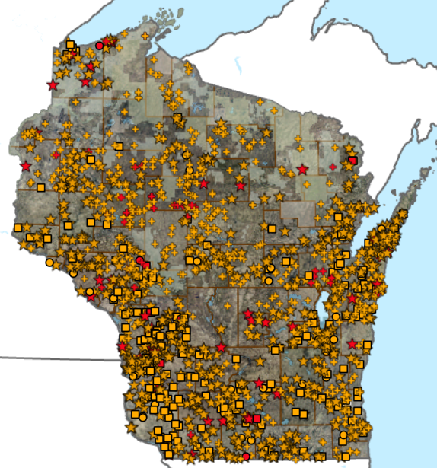
System Conditions
Small Bridges (6-20’): The Progress We’ve Made, The Work to Do
Nearly 17,000 Structures Inventoried
1,600+ Poor/Severe Structures
36

Slide 37
Revenue Options
37

Slide 38
Revenue Options
Neighbors Have More & Growing User Fee Options
State | Fuel Tax | Fuel Sales Tax (1) | Fuel Tax Indexing | Vehicle Reg. Fee | New Vehicle Fee | Bonding | Toll Roads/ Bridges | Delivery Fees | General Funds
Illinois | X | X (2) | X | X |  | X | X |  | X
Indiana | X | X | X | X |  | X | X |  | X
Iowa | X |  |  | X | X (4)
Michigan | X | X (3) | X | X |  | X | X |  | X
Minnesota | X |  | X | X | X (5) | X | X | X | X
Wisconsin | X |  |  | X |  | X |  |  | X
A cents-per-gallon equivalent.
Starting 6/1/2026, Illinois will use the sales tax on gas to help fund public transit.
Effective 1/1/2026 Michigan’s 6% sales tax on gas becomes a 20- cent increase to the excise tax.
There is no sales tax on auto purchases, but a 5% new car reg. fee.
Sales tax on auto sales goes toward transportation.
38

Slide 39
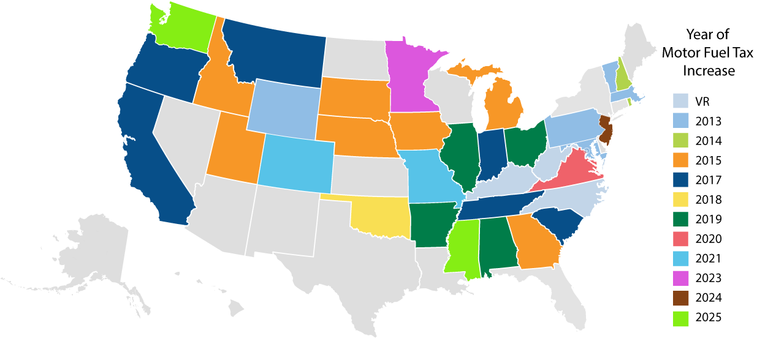
Revenue Options
35 States Legislatively Adjust State Motor Fuel Taxes 2013 - 2025
59
33.8
31.4
31.4
40
23
31.9
23.8
33
30
32.9
32.6
27.5
24
25
48.2
41.1
23.8
32.7
30
58.7
45
39.2
66.4
54.5
38.5
23
70.9
29.2
35.7
46.2
25
30
41.6
26.4
27.4
40.6
19
20
18.9
25
28.8
9
21.4
31.0
33.9
20
20.9
39.4
18.5
Includes all fees on gas, including some that do not go to transportation, as of July 1, 2025.
39

Slide 40
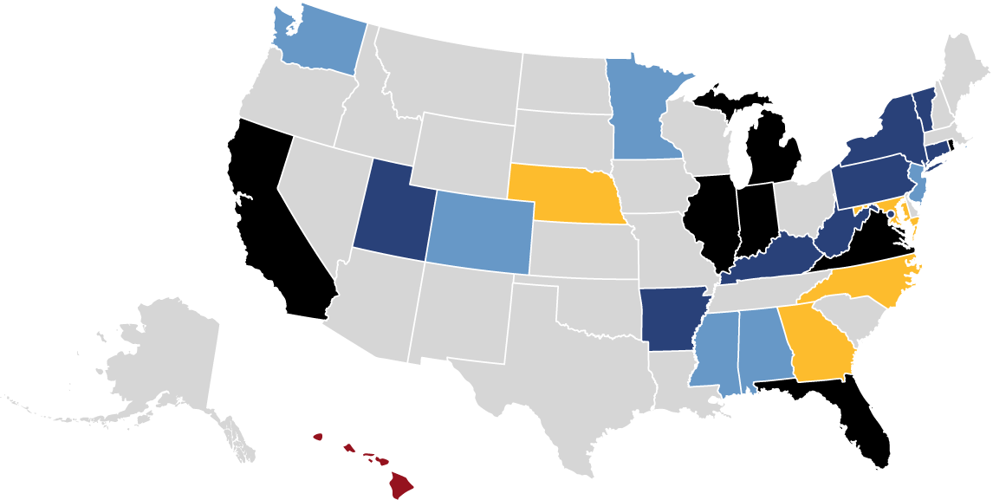
Revenue Options
26 States & DC Use Variable-Rate State Gas Taxes
Changes in Inflation
Average Wholesale Price
State Sales Tax Applies
Combination
Other
No Variable-Rate Gas Tax
40
Notes:
https://transportationinvestment.org/research/funding-techniques/variable-rate-state-motor-fuel-taxes/

Slide 41
Revenue Options
Two States Have Enacted a Retail Delivery Fee
Colorado: 2021
A flat $0.29 (current rate) on certain deliveries with at least one item of tangible personal property subject to state sales or use tax, adjusts annually based on inflation.
Collected Revenue: $84.9 million in FY 2023-2024.
Minnesota: 2023
A flat $0.50 fee on select retail sales transactions over $100, collected by the retailer.
Expected Revenue: $65.3 million in Fiscal Year 2027
Taxes or fees on retail deliveries ensure delivery vehicles, which are often heavier, make frequent trips, and put additional wear and tear on roads and bridges, contribute to infrastructure maintenance and improvements
41
Notes:
https://transportationinvestment.org/wp-content/uploads/2023/10/Retail_Package_Delivery_Fees.pdf

Slide 42
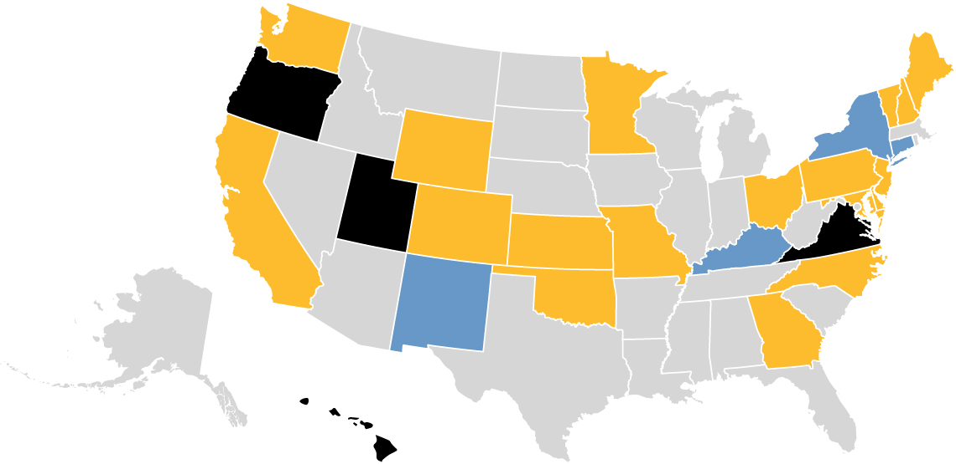
Revenue Options
Four State Have Active Road User Charge Programs
Other states have studied charging by vehicle miles traveled.
Optional Program
Weight/Distance Fee –
Commercial
State Pilot, Study or Research
42
Notes:
https://transportationinvestment.org/wp-content/uploads/2024/01/Road_Usage_2024.pdf

Slide 43
Conclusion
43

Slide 44
Conclusion
2027-29 Shortfall Over $1 Billion
Infrastructure Targets (in Millions $):
Highway Capital Improvement Projects | 2027-2029
I-41 | $209
US 51 Stoughton to McFarland | 47
I-39/90/94 to the Dells | 500
US-51 US 12 to WIS 19 | 12
I-94 East-West | 499
Total | $1,267
Amount Over Base Funding (excluding bonding) $560 Million
Local Capital Assistance (LRIP-S & ARIP) $250 Million
One-Time GPR Less One-Time Uses Including LRIP/ARIP $295 Million
Maintain SHR & Other Program Purchasing Power $200 Million+
Estimated Shortfall: $1.3 Billion+
44

Slide 45
Conclusion
Without Long-Term Fixes, Structural Shortfalls Return and Grow
$1 billion/year shortfall was well-documented by multiple reports, but it doesn’t reflect all Wisconsin’s evolving needs.
Wisconsin made progress in the 2019-21, 2023-25, & 2025-27 budgets, but fixed flat fees and one-time funding don’t keep up with inflation and structural deficits.
An influx of funds from the federal infrastructure law helped but didn’t solve the long-term Trust Fund challenges. Surface reauthorization expires in 2026, with ongoing funding uncertain.
45

Slide 46
Conclusion
It’s Time to Evaluate the Options
X Fuel-based options
X VMT
(low tech)
X VMT
(high tech)
X Sales tax on autos, & auto parts
X Weight/value/efficiency-based registration fee
X Right of way fees
Revenue Generating Ability
$100 Million
Per Year
X Retail delivery fees
X Tolling
Time to Implement
46

